Slide 1
2017-18

Slide 2
What we offer:
Individual Counselling
Group Counselling
Career Guidance
Psychometric Assessments and Remedial sessions for students with special needs.
Workshops/Seminars/
Awareness programs

Slide 3
Areas focused on:
Academic difficulties
Attention Enhancement
Self –Esteem Development
Emotional regulation
Anger management
Study skills and Time management
Stress/Anxiety management
Abuse
Problem Solving and Decision making
Coping skills
Family issues
Self awareness
Identity crisis
Exam stress
Career guidance

Slide 4
Group Counseling
Areas focused on:
Psychoeducation
Social skills development
Team building activities
Conflict resolution
Handling peer pressure
Bullying
Career development
Substance abuse/Addiction awareness

Slide 5
Interventions
Person-centered approach
Behavior modification techniques
Cognitive-behavior therapy (CBT)
Rational emotive behavior therapy (REBT)
Psychotherapy
Transactional Analysis
Mindfulness based therapies
Family therapy

Slide 6
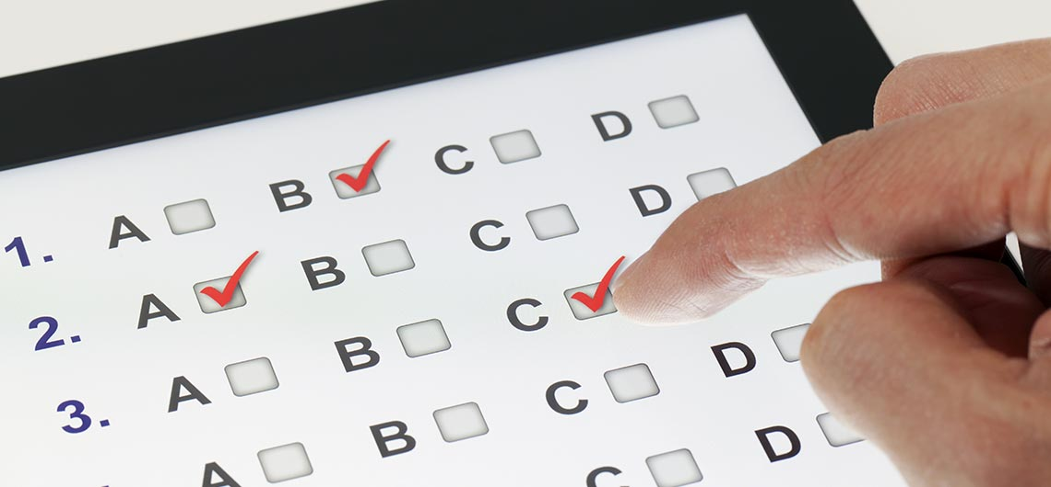
ASSESSMENT /TEST
Aptitude Tests
Emotional Quotient (EQ)
Intelligence Tests (IQ)

Slide 7
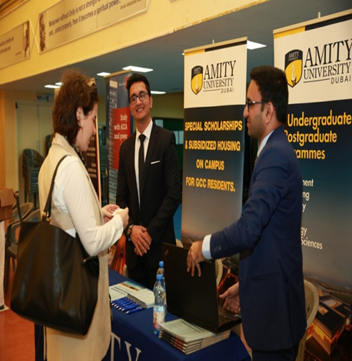
Career guidance Programs

Slide 8
Recommendations
Counselor Recommendation to Abroad universities

Slide 9
College Education

Slide 10
Key Points
Scholastic Aptitude Test (SAT)
Direct Admissions to students abroad (DASA).
Entrance Exams in INDIA

Slide 11
Scholastic Aptitude Test (SAT)
Significance
Scholastic Assessment Test (SAT) is an entrance exam used by most colleges and universities in the US, Canada as well as other countries to select students for admissions to undergraduate courses.
Direct Admissions to students abroad (DASA).

Slide 12
Direct Admissions to students abroad (DASA)
Eligibility : NRIs (Non Resident Indian), foreign nationals and PIOs (Person of Indian Origin) are eligible for the DASA scheme.
Requirements: SAT 2
Subjects: Physics, Chemistry, Mathematics.
Min SAT Score: 1440/ 2400(conditions applied).

Slide 13
Scholastic Aptitude Test (SAT)
Application
Website: https://collegereadiness.collegeboard.org
Eligibility: grade XI and XII.
School code:
Indian School Al Wadi Al Kabir 688002

Slide 14
SAT Exam Dates 2018
Test Dates 2018

Slide 15
In-house Events
Career seminar
Substance abuse awareness

Slide 16
Parents’ Referral
Study skills
Grades
Inattentiveness
School dislike
Relationship with teachers/parents
Relationship with peers
Adjustment in school
Adjustment at home
Career concerns
Exam stress
Self esteem/Confidence
Anger
Bullying
Family issues
Unhealthy/Unsafe choices
Grief/Loss of a loved one
Obsessions/Compulsions
Isolation/Social withdrawal

Slide 17
ranjitasabnis@iswkoman.com
afshanshariff@iswkoman.com

