Slide 1
INDIAN SCHOOL AL WADI AL KABIR WELCOMES YOU
TO THE PARENT ORIENTATION PROGRAMME 2018

Slide 2
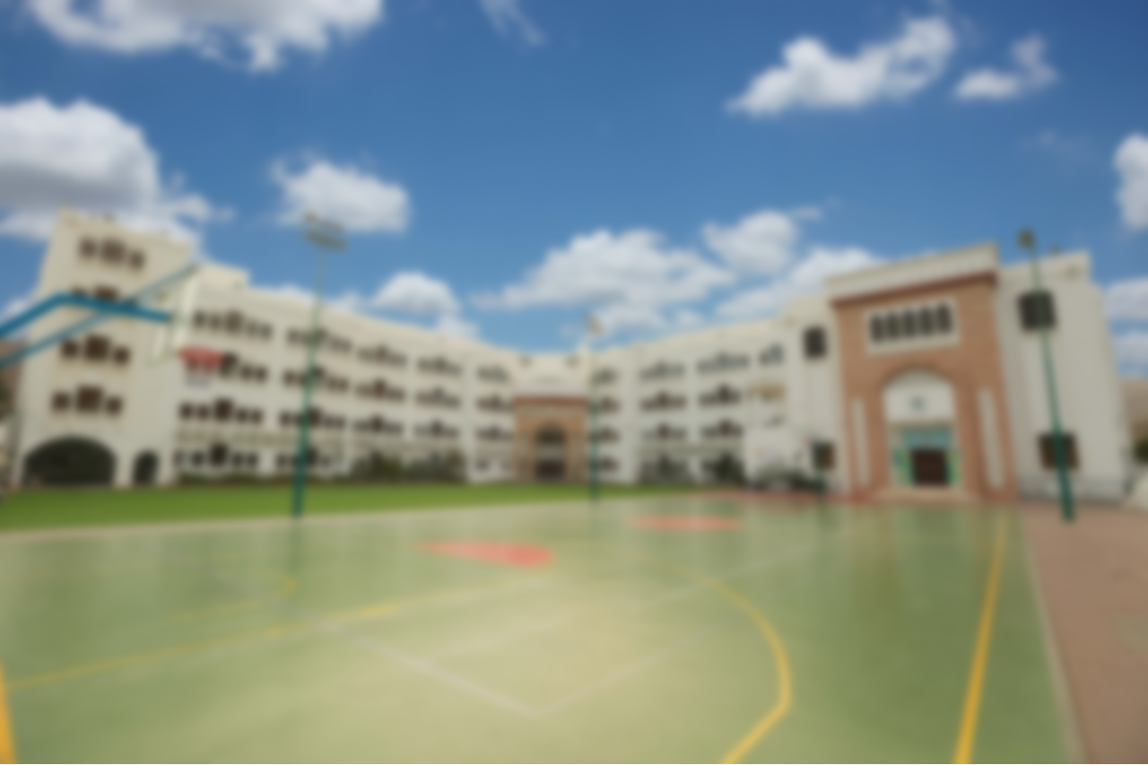
INDIAN SCHOOL AL WADI AL KABIR
1 | Stream Selection of class XI depends on the overall percentage of class X examinations
2 | Stream Change is not possible after board exam results.
3 | One week’s time is given to change the subjects , after the start of the class
4 | After one week change of stream or subjects is not allowed
5 | Promotion to class XII depends upon the overall performance
6 | A separate minimum is required for papers involving practical/ projects.
7 | After every exam, a review of students’ performance will be done

Slide 3
Special class for class XII 2017-2018
INDIAN SCHOOL AL WADI AL KABIR

Slide 4
Academic Specific Subjects
Accountancy, Business Studies,PE
Economics, Entrepreneurship
Mathematics, Informatics, Psychology
Commerce
Physics, Chemistry, Biology
Engineering Graphics, Mathematics
Computer Science / Informatics
Science
English
Physical Education
Work Experience, General Studies

Slide 5
Exam Pattern for XI
Unit Test (30 marks) (10% weightage) | 15th May 2018 onwards
Review of students performance for CBSE registration
June 3rd to July 31st | Summer vacation
Assessment-1(70/80/90/100 marks) (20% weightage) | 12th Sept 2018 onwards
Assessment-2(70/80/90/100 marks) (20% weightage) | 11th Dec 2018 onwards
December 21st 2018 to Jan 12th 2019 | Winter Break
Syllabus Completion | 7th Feb 2019
Assessment-3(70/80/90/100 marks) (50% weightage) | 19th Feb 2019 onwards
New Academic year for class XII begins | March 13th 2019

Slide 6
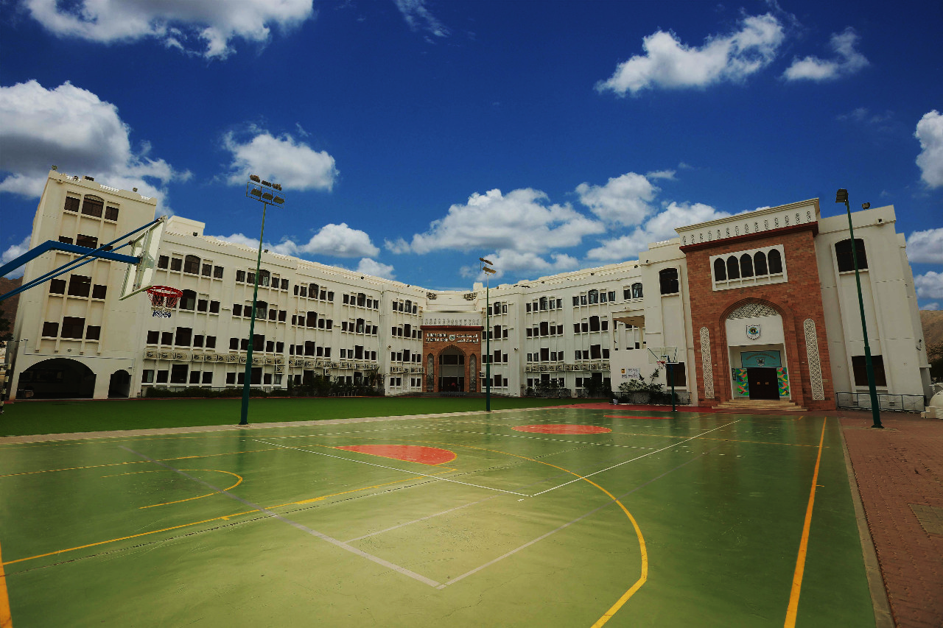
DISCIPLINE PROCEDURE OF THE SCHOOL

Slide 7
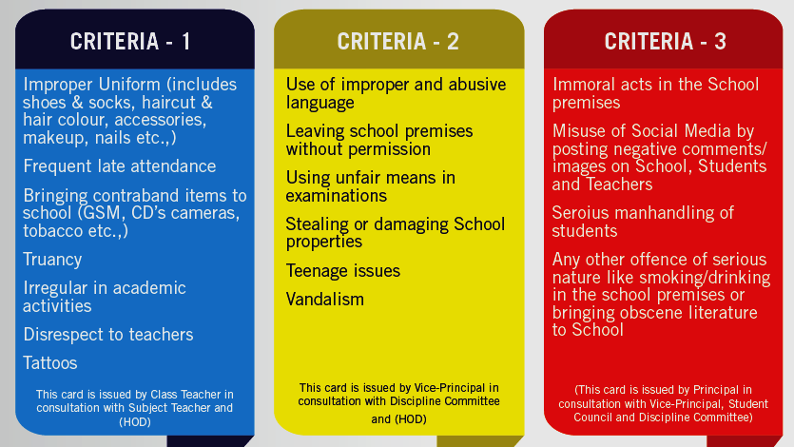
Serious

Slide 10
Thank You

