Slide 1
Computer Education
CLASS
I

Slide 2
“ In a world that’s increasingly run on technology, computer science is a liberal art that every student should be exposed to regardless of their path in life.”
~HADI PARTOVI

Slide 3
The major objectives of Computer Education
To develop the hand and eye coordination of a child
To help children to excel in the usage of the computer peripherals.
To develop innovative and creative ideas in them.
To make learning an enjoyable experience.

Slide 4
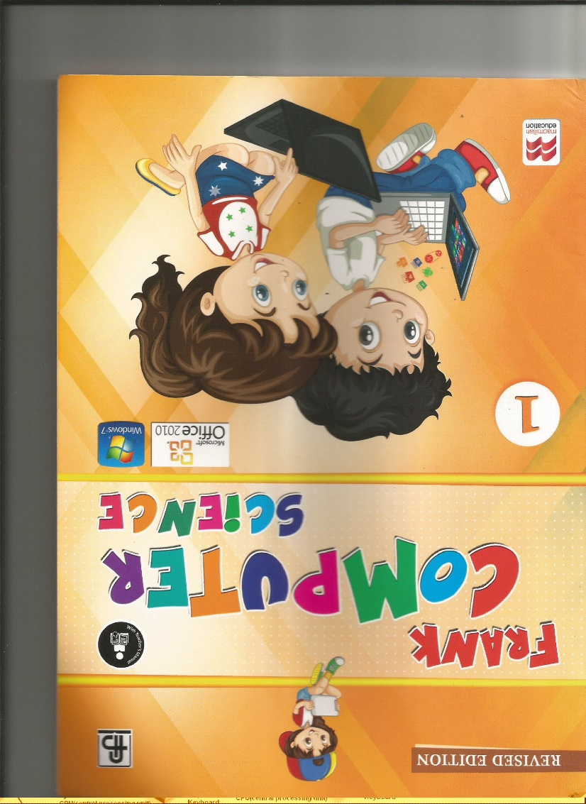

Slide 5
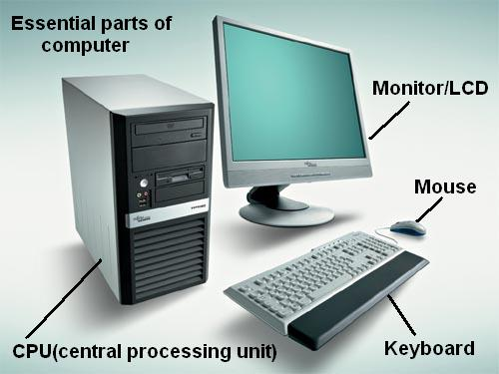
Introduction to computers – Parts of the computer
Syllabus
PARTS OF THE COMPUTER

Slide 6
Types of Computers

Slide 7
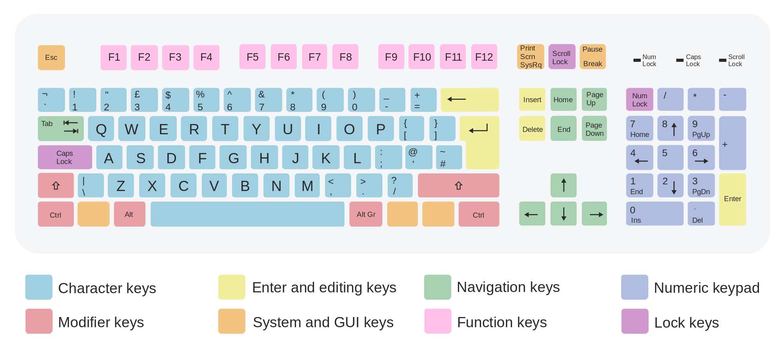
Introduction to the keyboard
WORDPAD
Different Keys – Number keys, Arrow keys etc.
Kids learning computers also need to learn the very important life skills of their developmental stage!

Slide 8
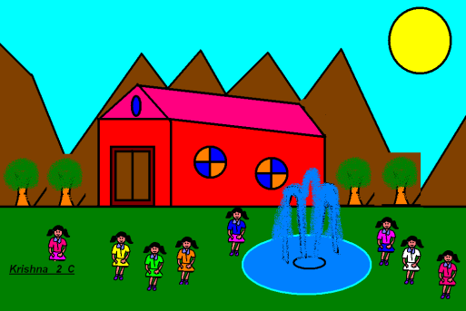
MSPAINT

Slide 9
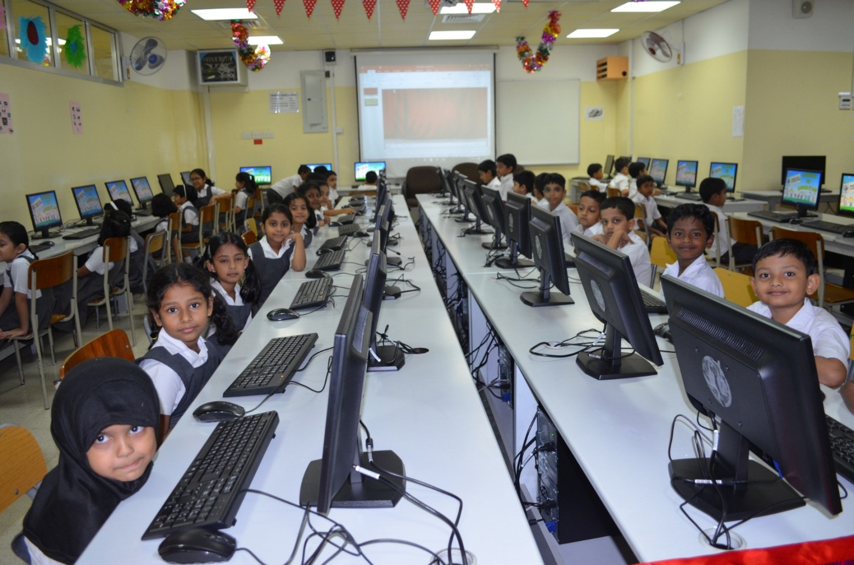
IT LAB – CLASSES I AND II

Slide 10
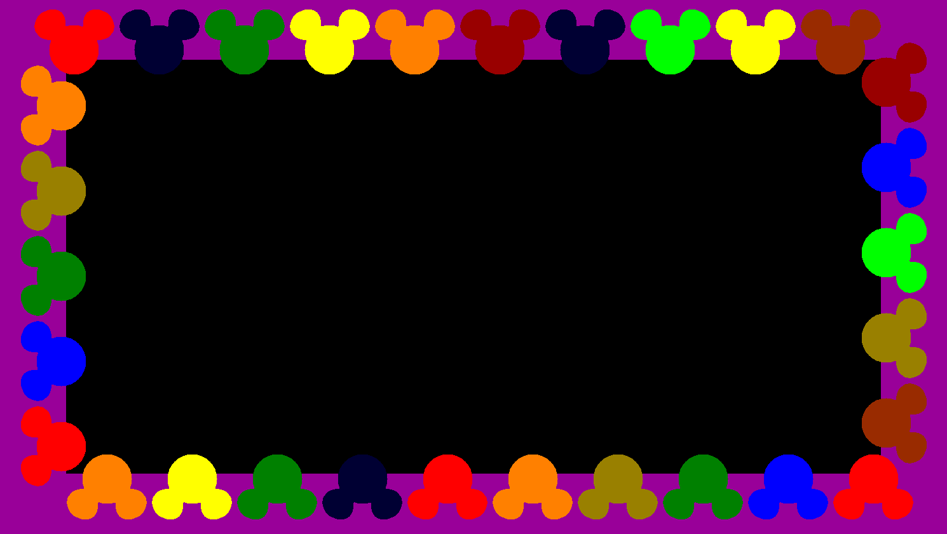
Lab activities

Slide 11
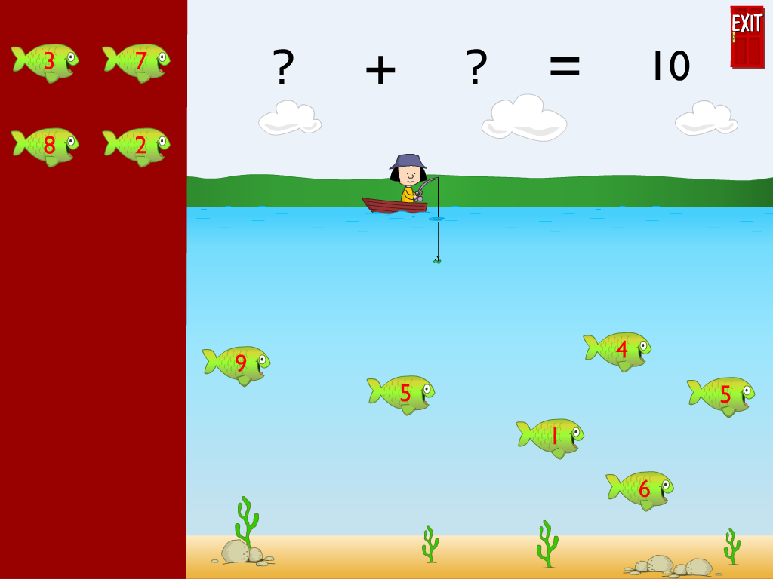
Educational software - Math Ahead
Pictorial Addition

Slide 12
Math Ahead – Counting

Slide 13
Math Ahead – Subtraction

Slide 14
Math Ahead – Calculating the time

Slide 15
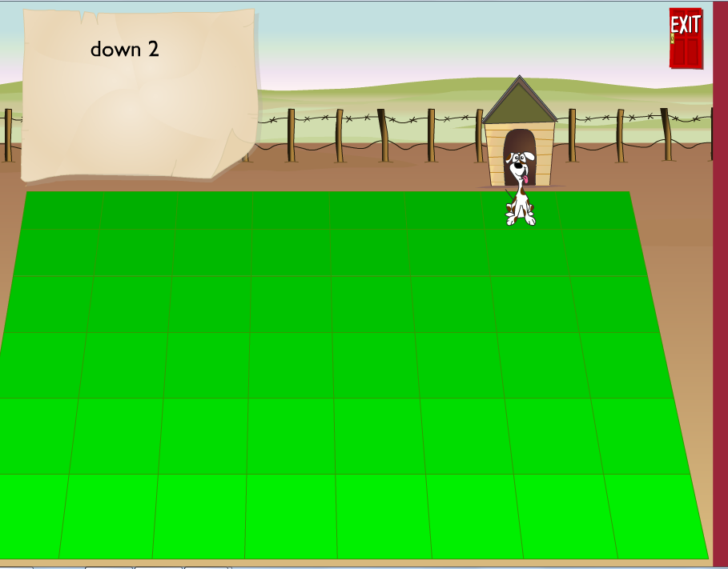
Math Ahead – Directional keys

Slide 16
EVS

Slide 17
ASSESSMENTS
PRE MID TERM EXAM– THEORY (10 MARKS)
MID TERM EXAM – THEORY (20 MARKS)
POST MID TERM EXAM – THEORY (10 MARKS)
FINAL EXAM – THEORY (20 MARKS)
ACTIVITY – 5 MARKS
COMPLETION OF THE
TEXTBOOK EXERCISES – 5 MARKS
TERM I
AND
TERM II

Slide 18
The practical Assessment is focused on the
following points
Learning and following the instruction given in the lab
Completion of the activity in the given period of time.
Skill in using their hands on the different input devices.
Enthusiasm or the effort to learn.

Slide 19
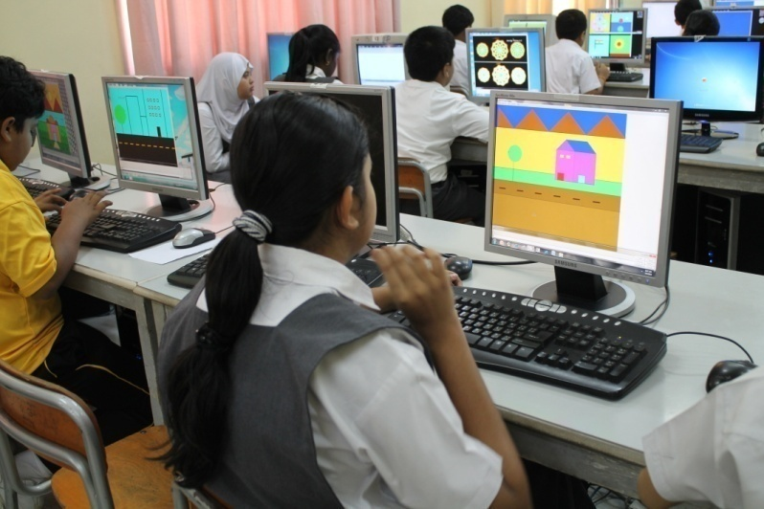
GENERAL INSTRUCTION
They will be having two computer classes per week.
We have the junior computer lab with 45 computers with Windows 10 OS & MS office - 2016
Each child works at an individual computer.

Slide 20
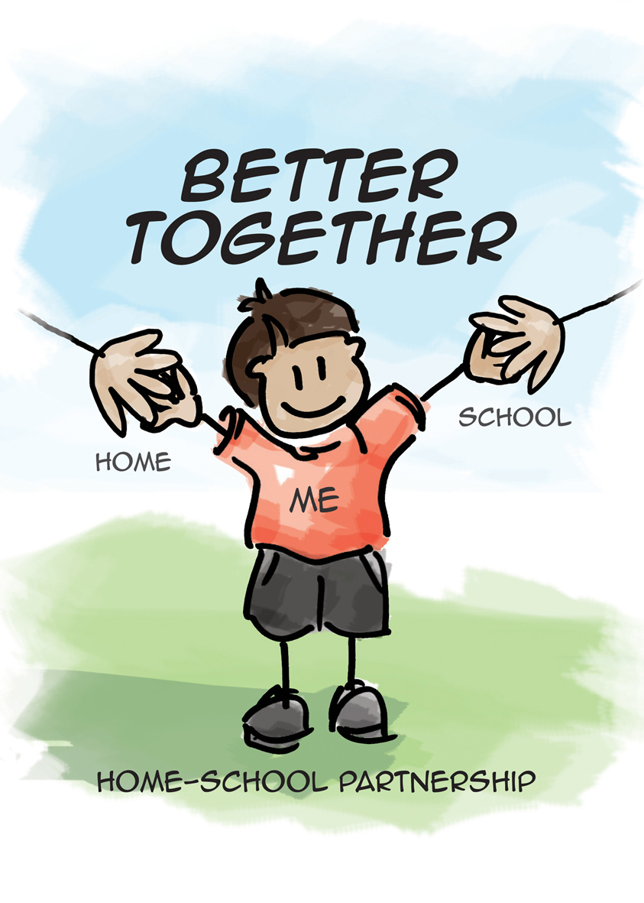

Slide 21
Thank You

