Slide 2
EVS
SOCIAL
ASPECTS
NATURAL
ASPECTS
CULTURAL
ASPECTS

Slide 3
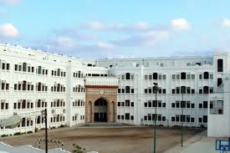
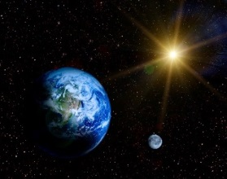
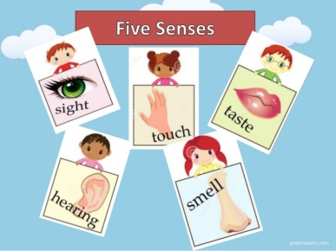
TOPICS
CLASS- I
About Me
Our Body Is Wonderful
Our Sense Organs
My Family
We Help One Another
Our Food
Our Clothes
We Need A House
Plant World
Plants Our Green Friends
Animal World
Places Near My Home
Our School
Our Classroom
Our Festivals
Growing Up
Good Manners and Habits
Safety Rules
Means of Transport
Our Earth
The Sky Above Us

Slide 4
Learner-centered methods:
Quality Circle Time
Audio-visual presentations
Group Activities
Experiments, Exhibitions and excursions
Data collection activities
Special Assemblies
Worksheets

Slide 5
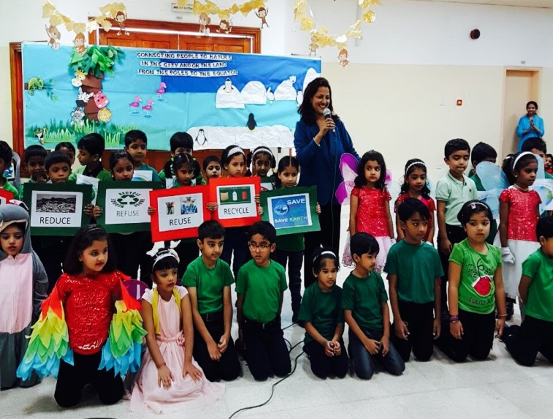
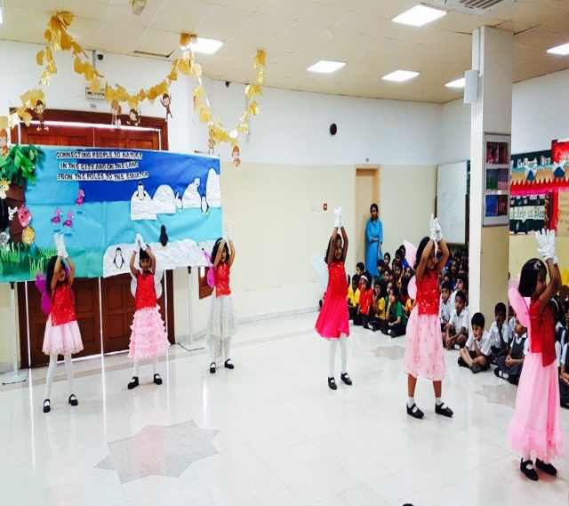
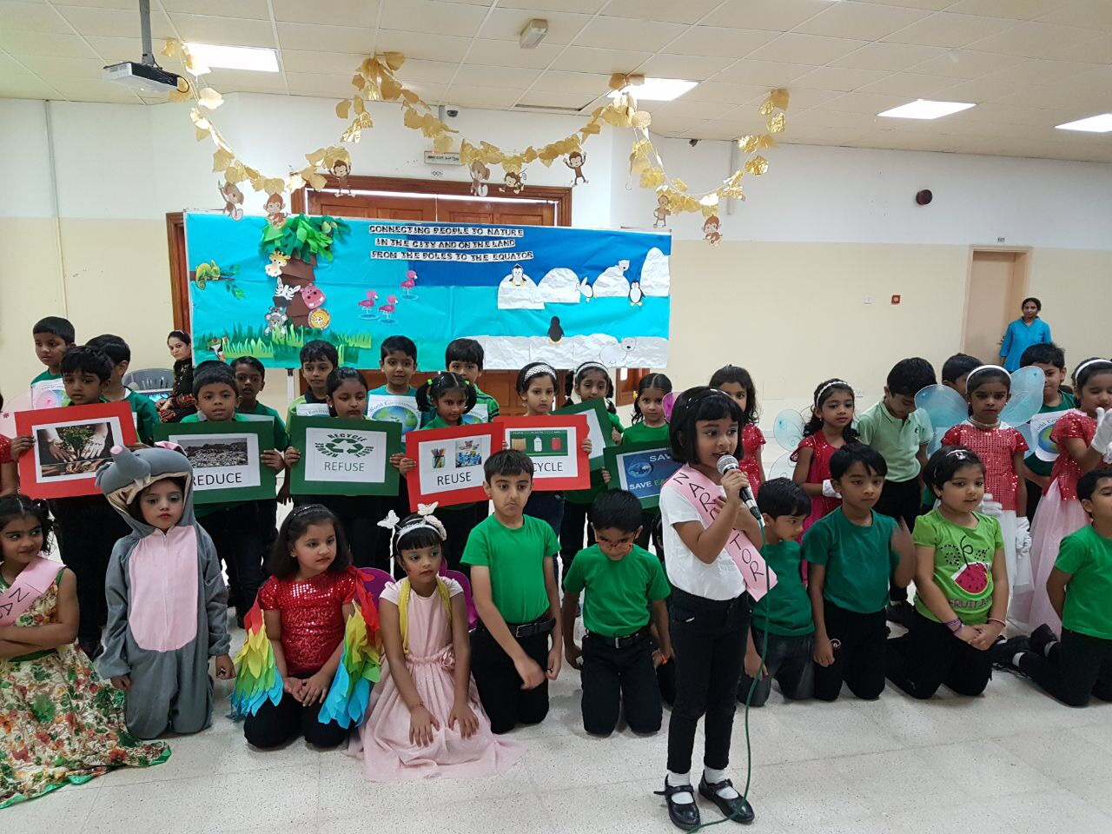
SPECIAL ASSEMBLY- THE ENVIRONMENT DAY

Slide 6
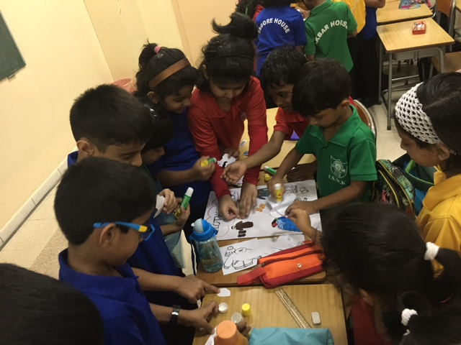
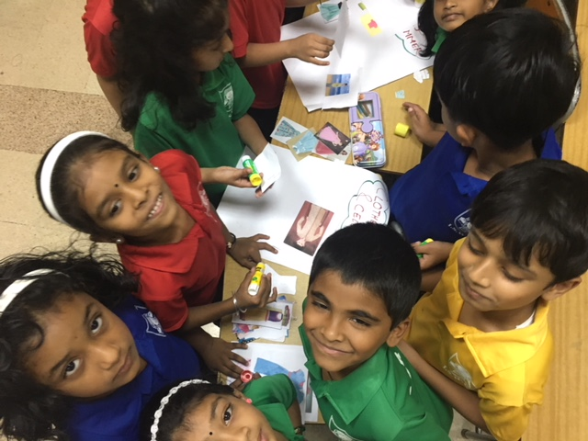
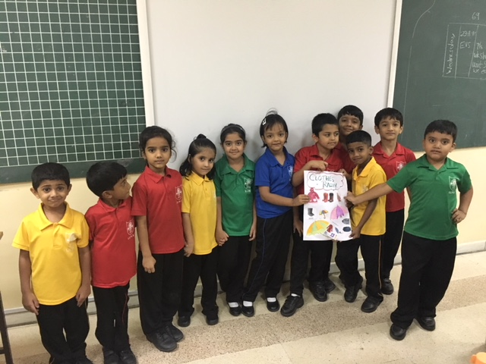
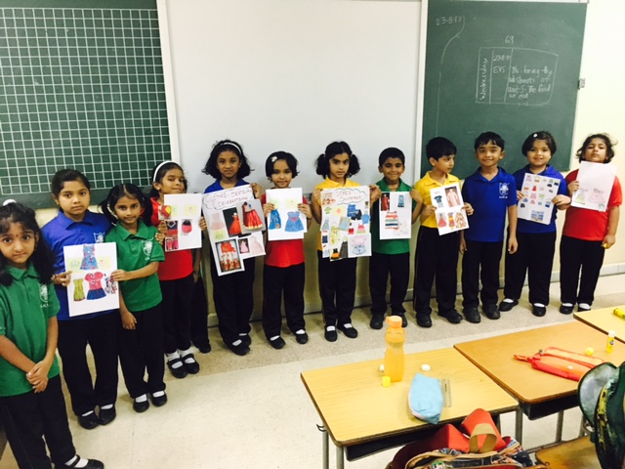
GROUP ACTIVITIES

Slide 7
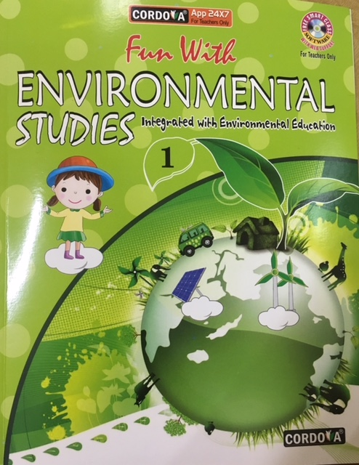
Textbook

Slide 8
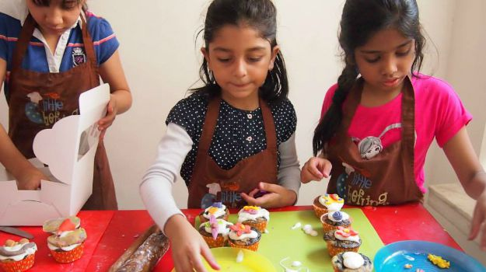
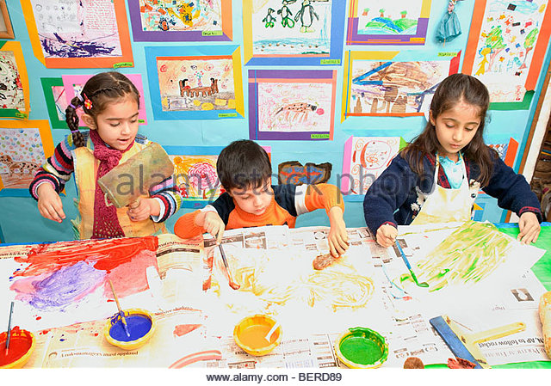
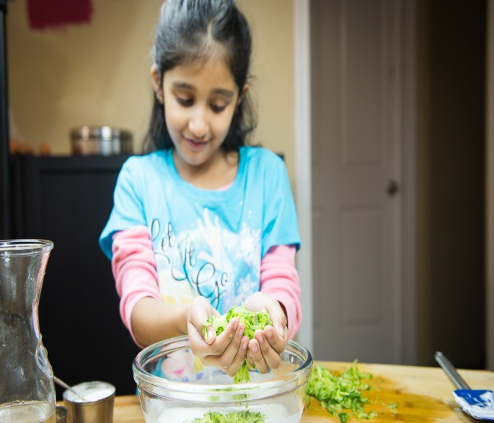
Learning by Doing

Slide 9
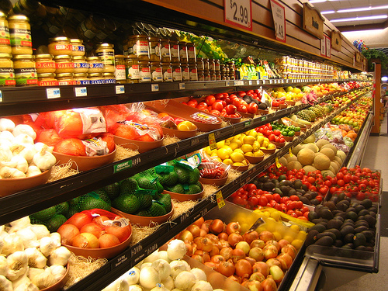
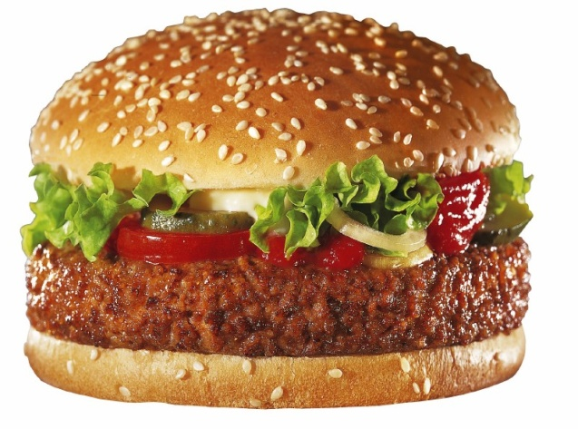
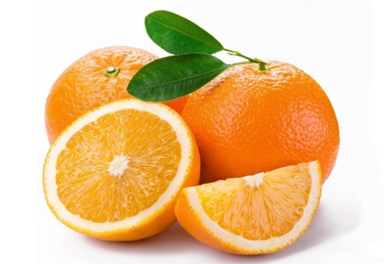
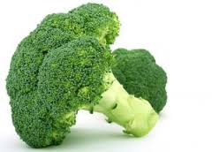
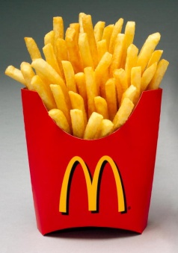
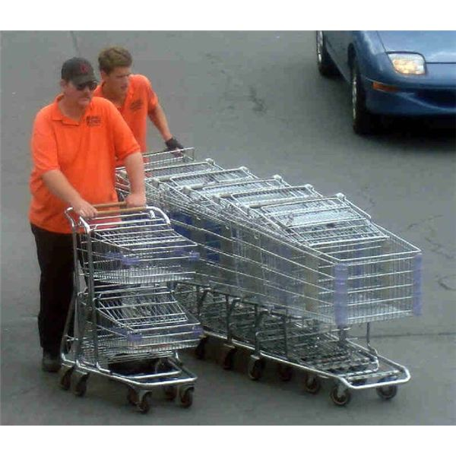
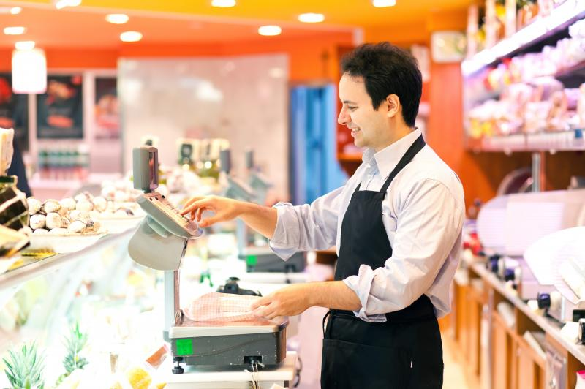
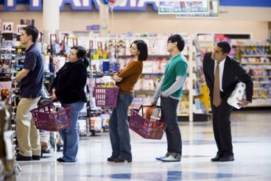
Environmental Science at a supermarket
Identification of fruits and vegetables.
Differentiating between healthy and junk food.
Identifying the community helpers.
Values - Standing in a queue and waiting for your turn.

Slide 10
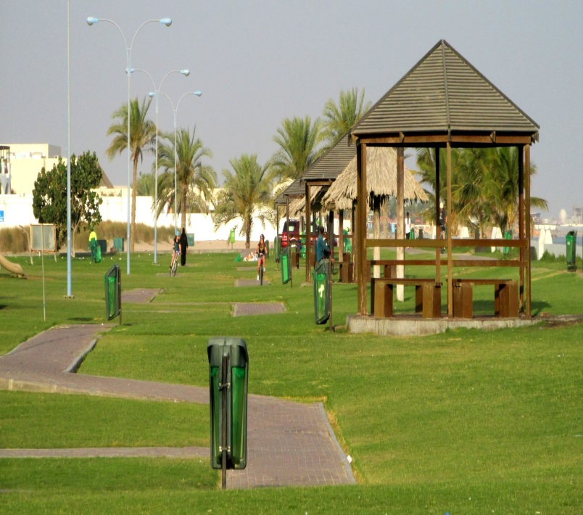
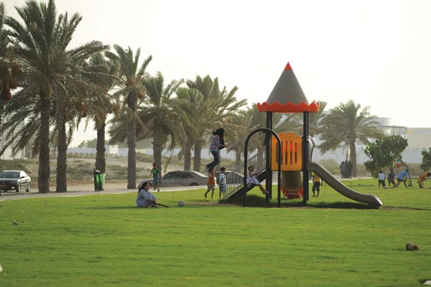
Environmental Science at a park
Observing and identifying different types of plants, trees, birds and insects.
Values – Preserving nature, waiting for your turn to play on the slides, keeping the surroundings clean, etc.

Slide 11
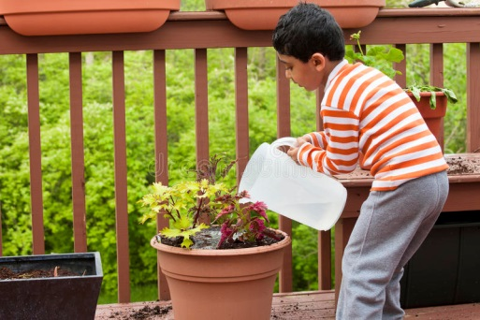
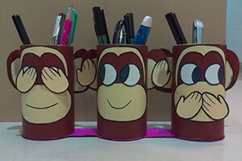
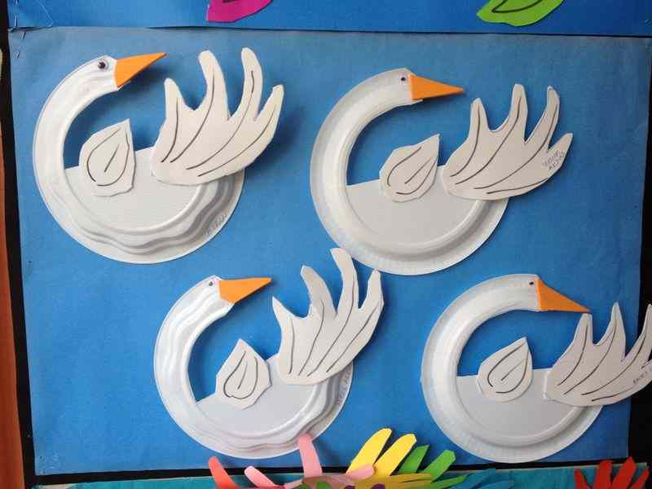
Environmental Science at home
Gardening activities- sowing the seeds or watering the plants regularly.
Drawing or sticking pictures from newspapers or old magazines.
Making models using waste materials or scraps.
Reading books.
Audio visual aids.

