Slide 1
Counselling & Special Needs
AREAS
Poor academic performance
Developmental Problems
Behavioral Problems
Peer Problems
Family Problems

Slide 2
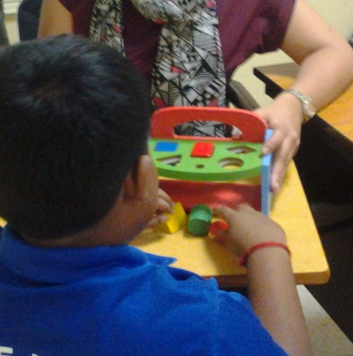
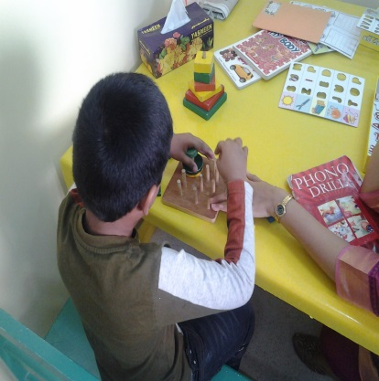
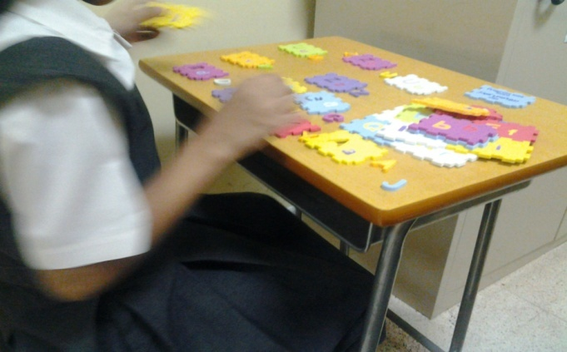
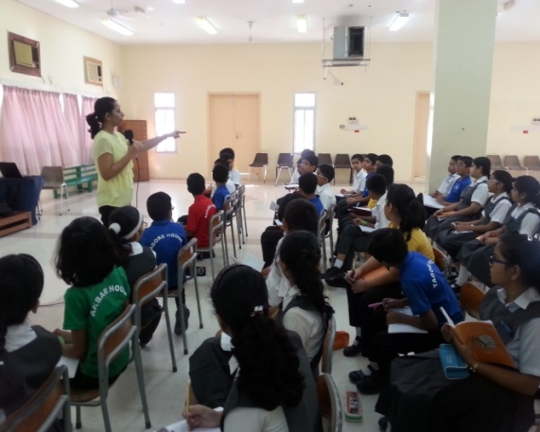
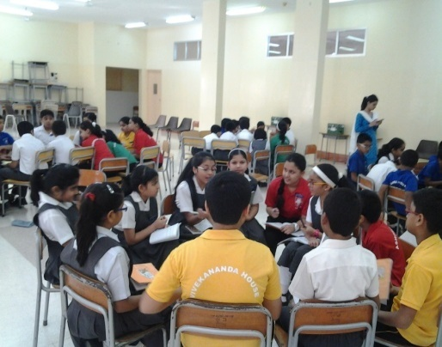
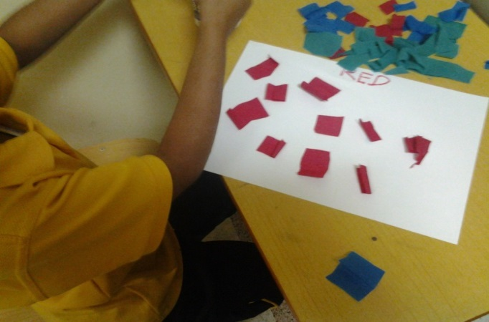
SERVICES
Guidance and counselling
Informal Assessments
Identifying Special needs
Remedial sessions
Individual exam support
External References
Workshops
Facilitate shadow support

Slide 3
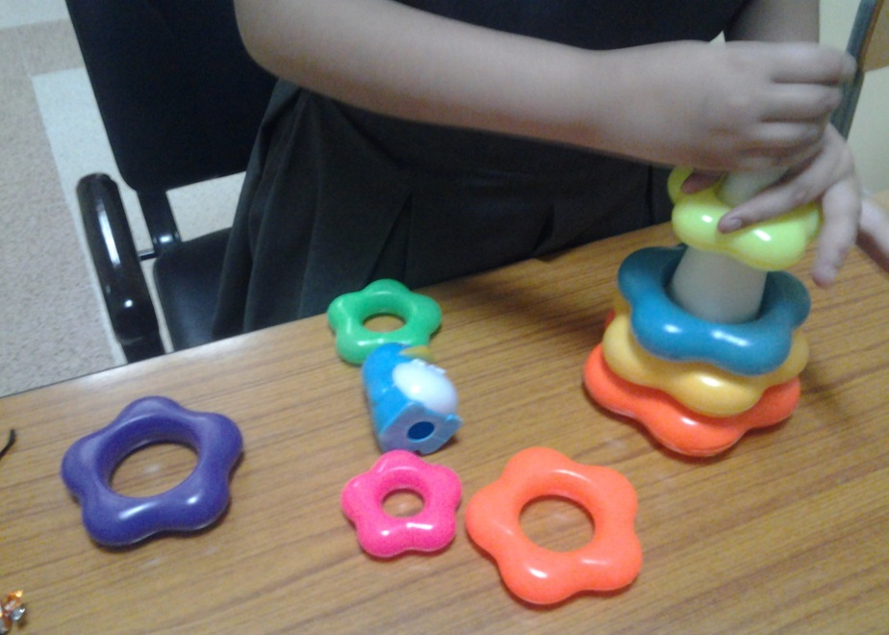
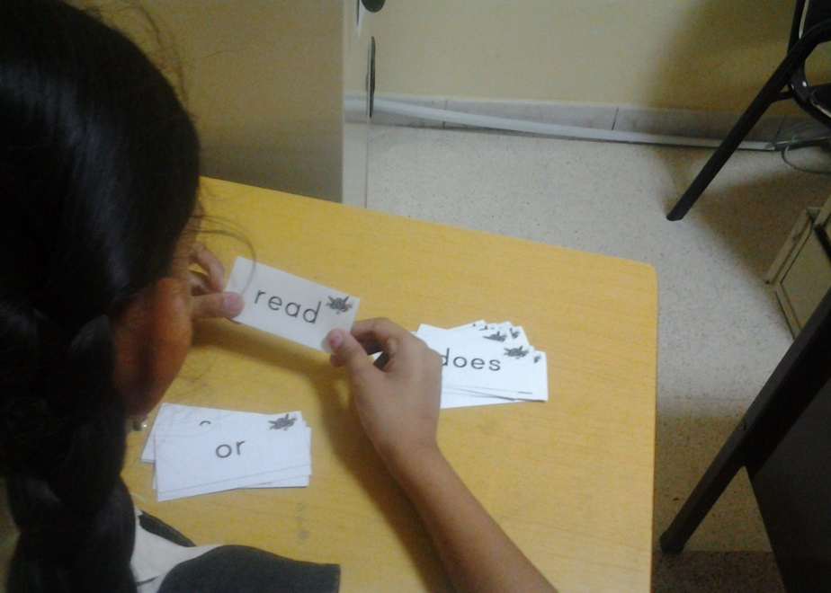
RESOURCE ROOM
Individual and Group Academic sessions
Attention & coordination activities
Play Therapy

Slide 4
Procedure
REFERRAL FORM
Parent
Teacher
OBSERVATIONS
Teacher
Parent
INFORMAL ASSESSMENTS
Counselor or Special Educator
Counselor/Special educator
CONSENT FROM PARENT
SPECIAL EDUCATION PROGRAM
EXTERNAL REFERENCES
Speech Therapy
Occupational Therapy etc.
Individual program

Slide 5
CONTACT DETAILS
COUNSELOR – Mrs. Metty Rubin
7.20 am – 4.00 pm
Basement – Primary Building
24814066 Ext.27
Afternoon Shift
counselor.metty@iswkoman.com
24814066 Ext. 28
KG Building,1st floor – Room no.133
specialeducator@iswkoman.com
Morning Shift
8.00 am – 12.00 pm
SPECIAL EDUCATOR- Mrs. Rashmi Patankar Joshi
Kindly note that prior appointment is mandatory.

