Slide 1
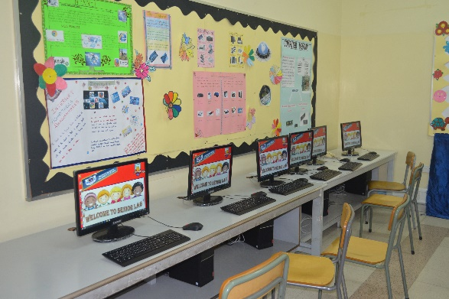
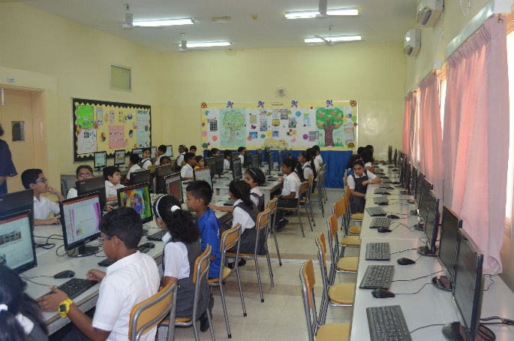
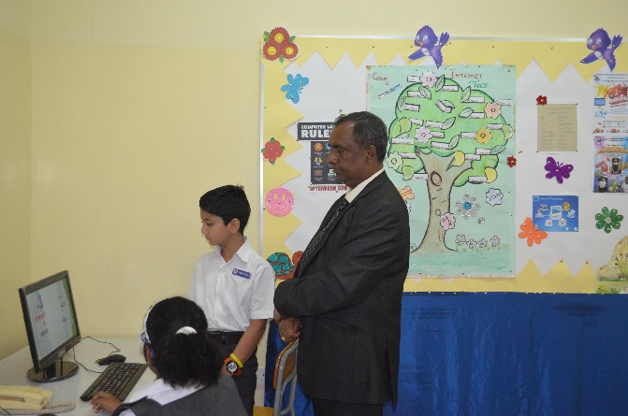

Slide 2
The major objectives of Computer Education
Developing the skills of using the technology.
Helping the children to become creative and innovative.
Helping children to improve the skills of typing, drawing, programming & logical thinking.
Developing a step-by-step approach to solve a problem.

Slide 3
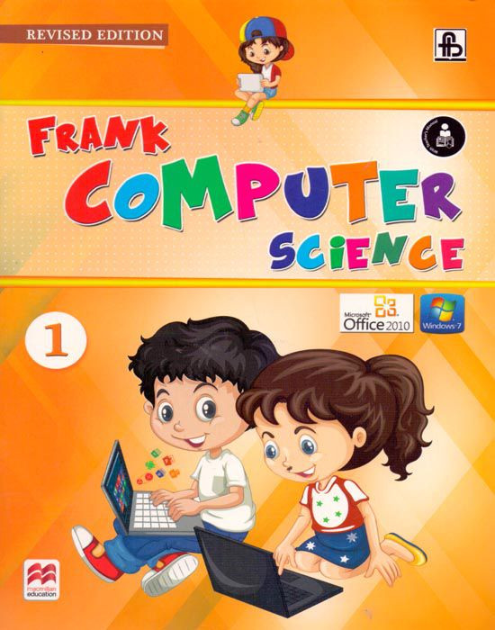
Textbook & Syllabus
MS – Windows 2010
MS – Paint
MS – Word 2016
MSW - LOGO
3

Slide 4
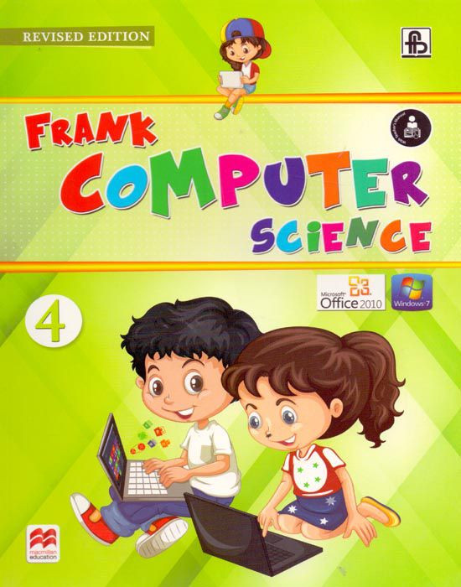
Textbook & Syllabus
MS – Windows 2010
MS – Word
MS – Powerpoint
More on LOGO

Slide 5
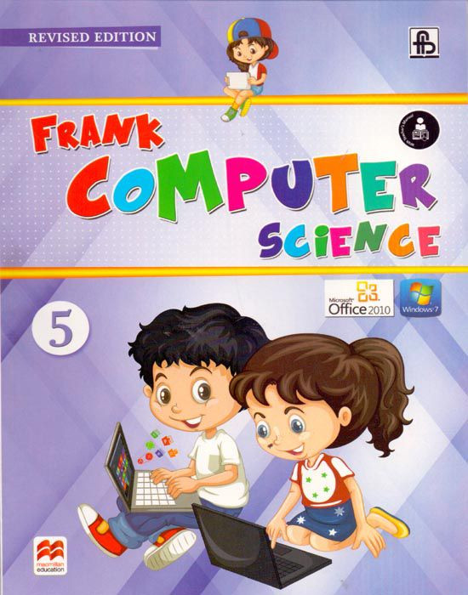
Textbook & Syllabus
MS Windows 2010
Hardware & Software
More on MS Word
More on MS PowerPoint
Exploring the Internet

Slide 6
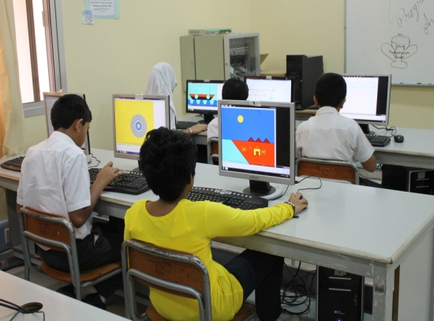
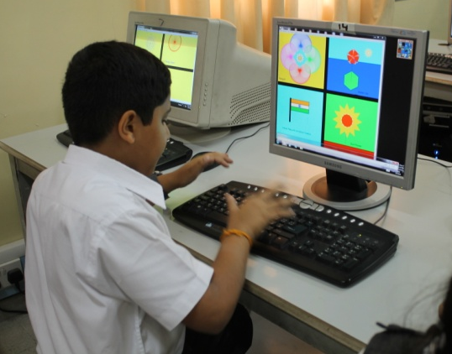
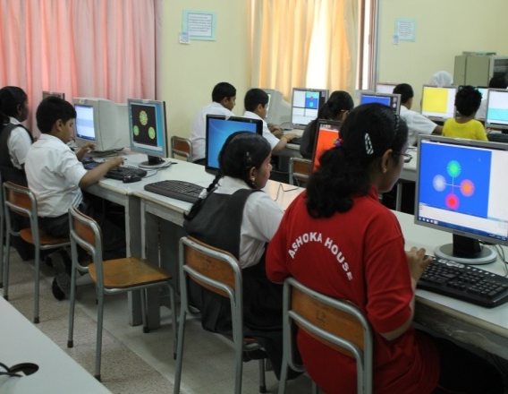
Assessment

Slide 7
Assessment
Pre Mid Term Exam & Post mid term – 10 marks
Mid Term Exam & final exam – 20 marks (Theory) & 10 marks (Practical)
Completion of the Textbook & Notebook exercises – 5 marks
Lab Activity & Class Activity – 5 marks

Slide 8
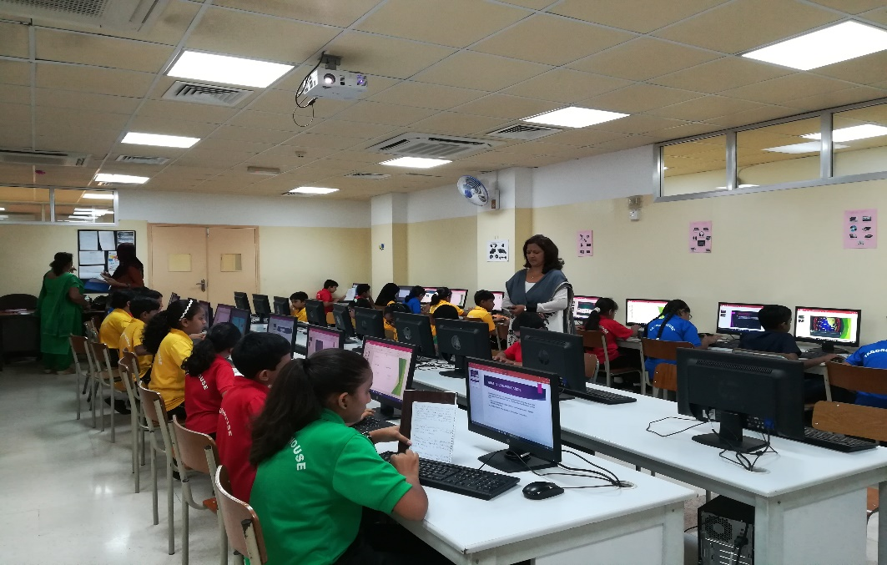
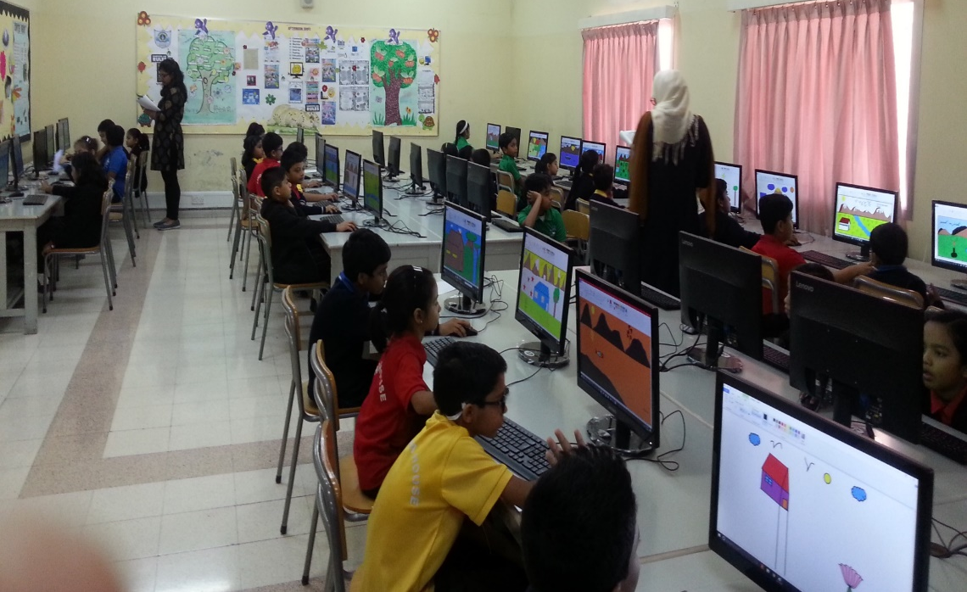
Competitions

Slide 9
The Practical Assessment is
focused on the following points
Learning and following the instruction given in the lab
Completion of the activity in the given period of time.
Applying the logics & techniques learnt in the class.
Enthusiasm to learn

Slide 10
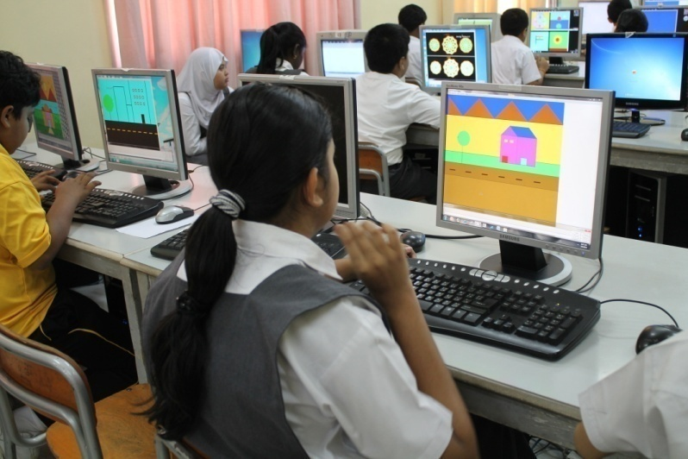
General Instructions
We have the senior computer lab with 50 computers with Windows OS – 10 & MS office - 2016
They will be having two computer classes per week.
Each child works at an individual computer.

Slide 11
