Slide 1
Department of Information Technology
Class XI - Computer Science ( Theory )
UNIT NAME | MARKS
COMPUTER FUNDAMENTALS | 10
PROGRAMMING METHODOLOGY | 12
INTRODUCTION TO C++ | 14
PROGRAMMING IN C++ | 34
TOTAL | 70

Slide 2
Class XI - Computer Science ( Theory )

Slide 3
Class XI - Computer Science ( Practical )
UNIT NAME | MARK
PROGRAMMING IN C++ (OOP) | 10
PROJECT WORK | 10
PRACTICAL FILE | 6
VIVA VOCE | 4
TOTAL | 30

Slide 4
Class XI - Computer Science ( Practical )

Slide 5
Class XI - Informatics Practices ( Theory )
UNIT NAME | MARKS
INTRODUCTION TO COMPUTER SYSTEMS | 10
INTRODUCTION TO PROGRAMMING | 25
RELATIONAL DATABASE MANAGEMENT SYSTEM | 30
IT APPLICATIONS | 5
TOTAL | 70

Slide 6
Class XI – Informatics Practices ( Theory)

Slide 7
Class XI - Informatics Practices ( Practical)
UNIT NAME | MARKS
Problem solving using JAVA | 10
SQL-Queries | 5
Practical Records | 6
Project Work | 5
Viva-Voce | 4
TOTAL | 30

Slide 8
Class XI – Informatics Practices ( Practical )

Slide 9
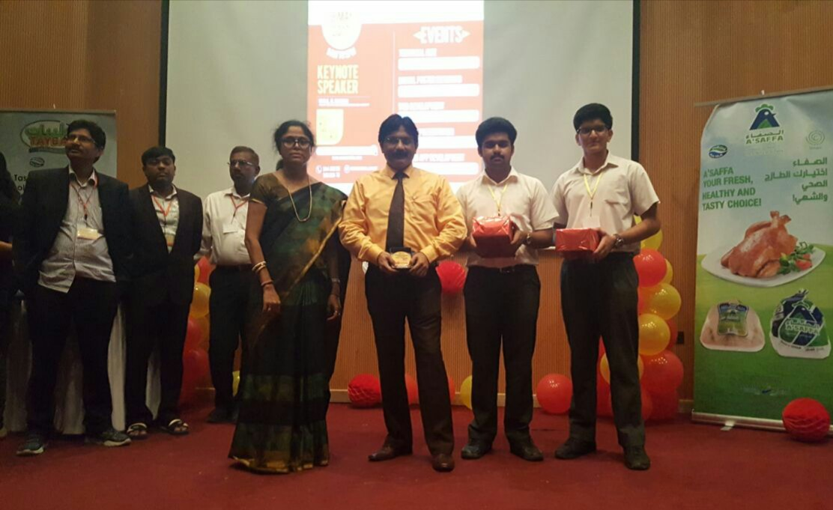
SECURED 1ST PLACE IN WEB DEVELOPMENT COMPETITION HELD AT
WALJAT COLLEGE OF APPLIED SCIENCES, MUSCAT ON 9TH MAY 2017

Slide 10
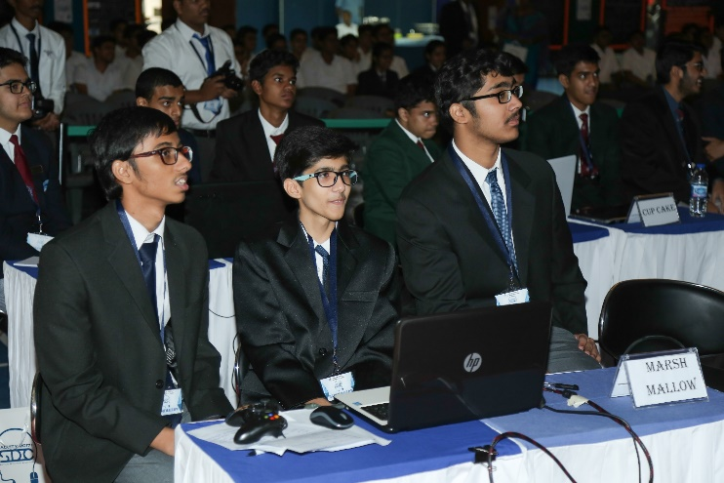
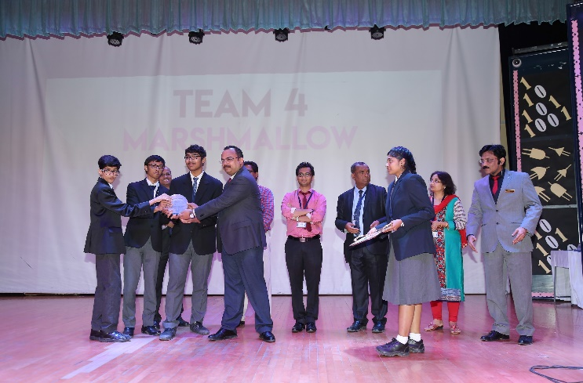
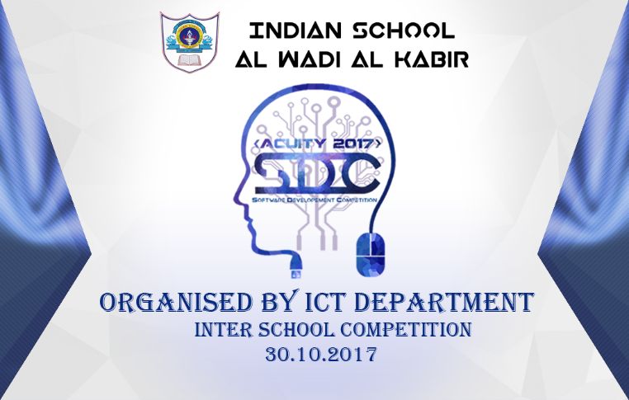
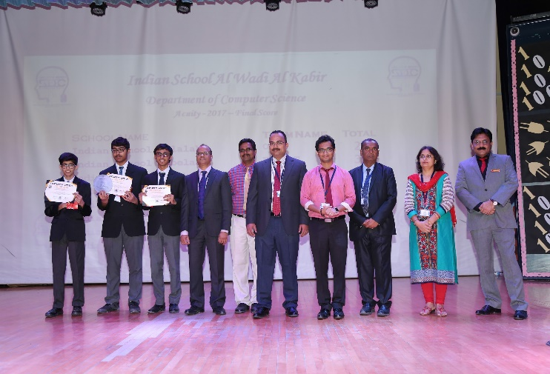
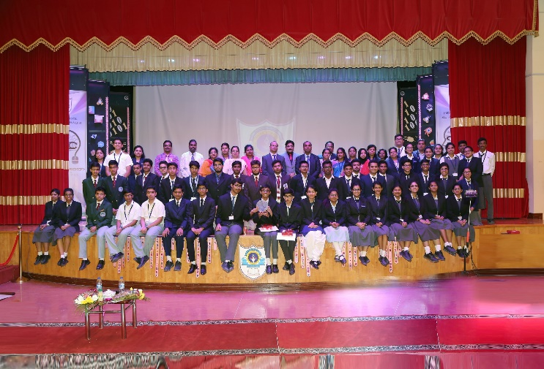

Slide 11
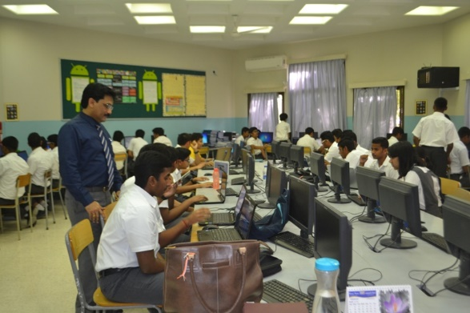
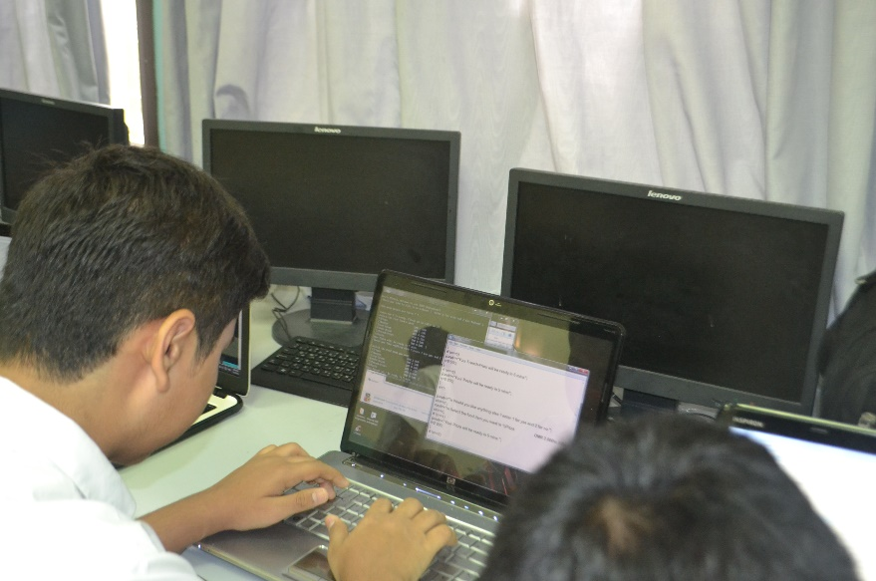
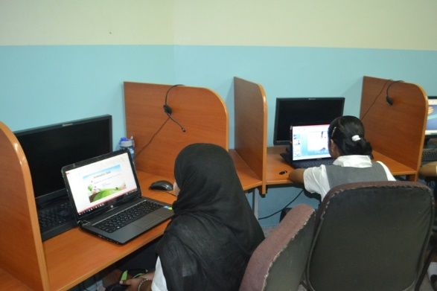
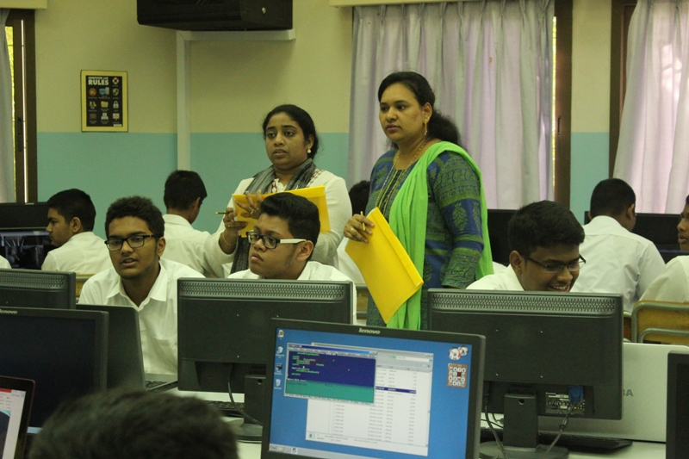
Talent Hunt Competition

Slide 13
For Further details click on www.iswkoman.com

