Slide 1
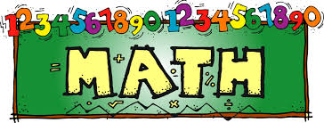
CLASS II
2018- 2019

Slide 2
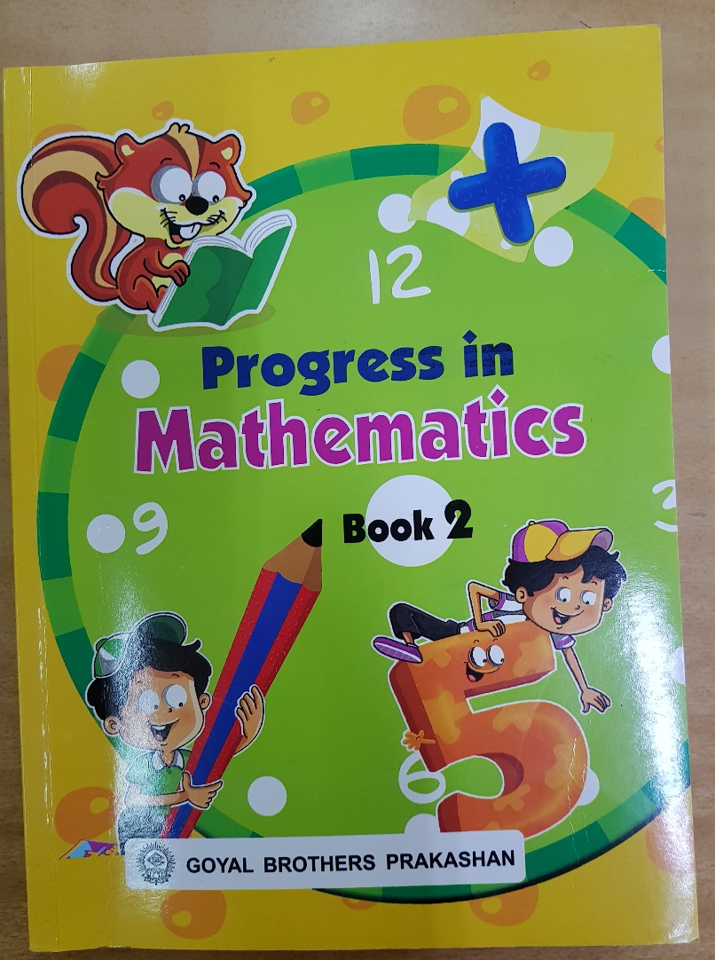
Textbook for class II

Slide 3
NUMBER CONCEPTS
(101-1000)
Ascending order / Descending order
Biggest / Smallest numbers
Odd / Even numbers
Ordinal number and Ordinal number names
Numbers Before / After / Between
Skip Counting
Place and Place Value
Abacus & Expanded Notation

Slide 4
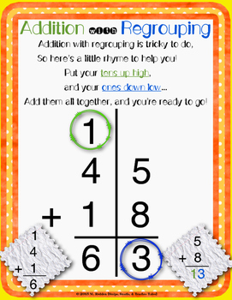
Addition with Regrouping

Slide 5
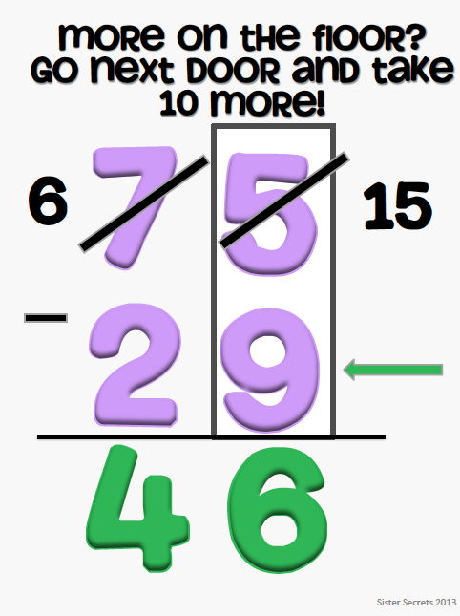
TWO DIGIT WITH TWO DIGIT (WITH BORROWING)

Slide 6
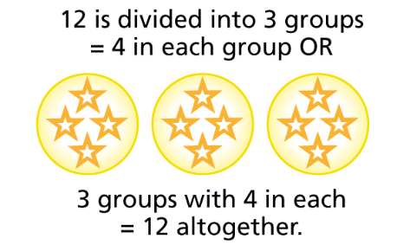
MULTIPLICATION
Multiplication means repeated addition
Addition Sentence: 4 + 4 + 4 = 12
Multiplication Sentence : 3 4 = 12

Slide 7
Building tables
Table of 1 ,2 , 3 , 4 , 5 , 6 & 10
Table of 5
1x 5= 5
2x5 = 10
3x5 = 15
10x 5 = 50

Slide 8
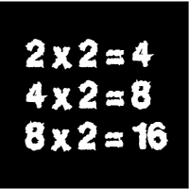
HORIZONTAL
VERTICAL
(with regrouping)
Two digit with one digit
T O
+1
2 5
x 3
----------
7 5
----------

Slide 9
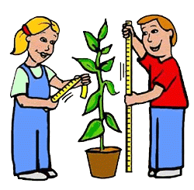
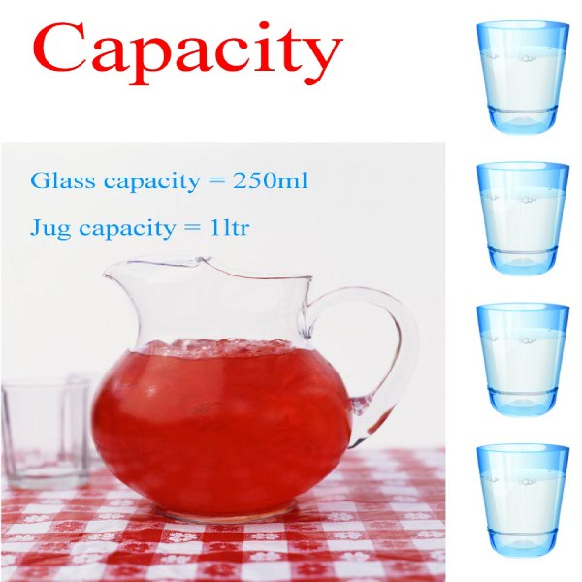
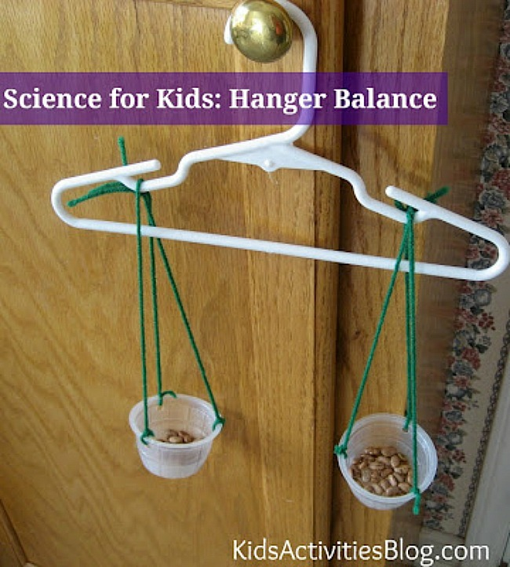

Slide 10
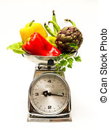
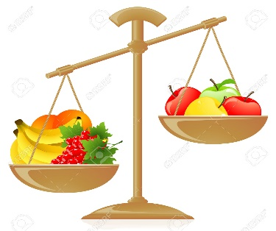
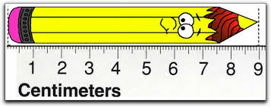
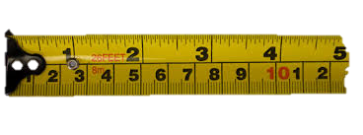
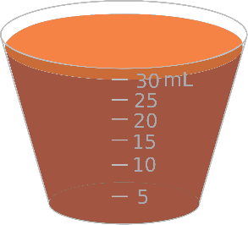
Measurement: Standard units
Weight
Length
Capacity
Distance
ml
litre

Slide 11
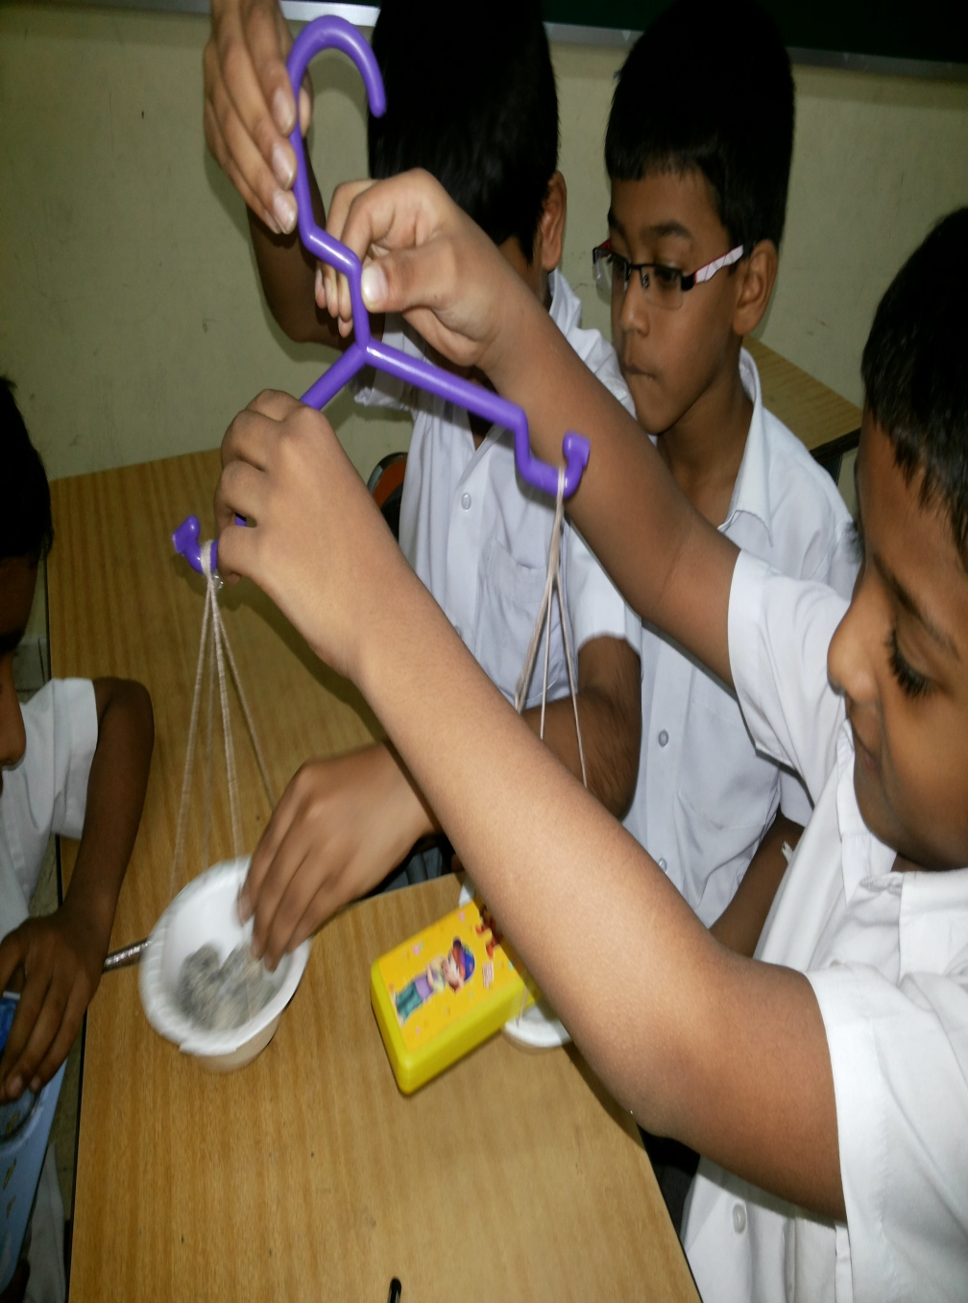
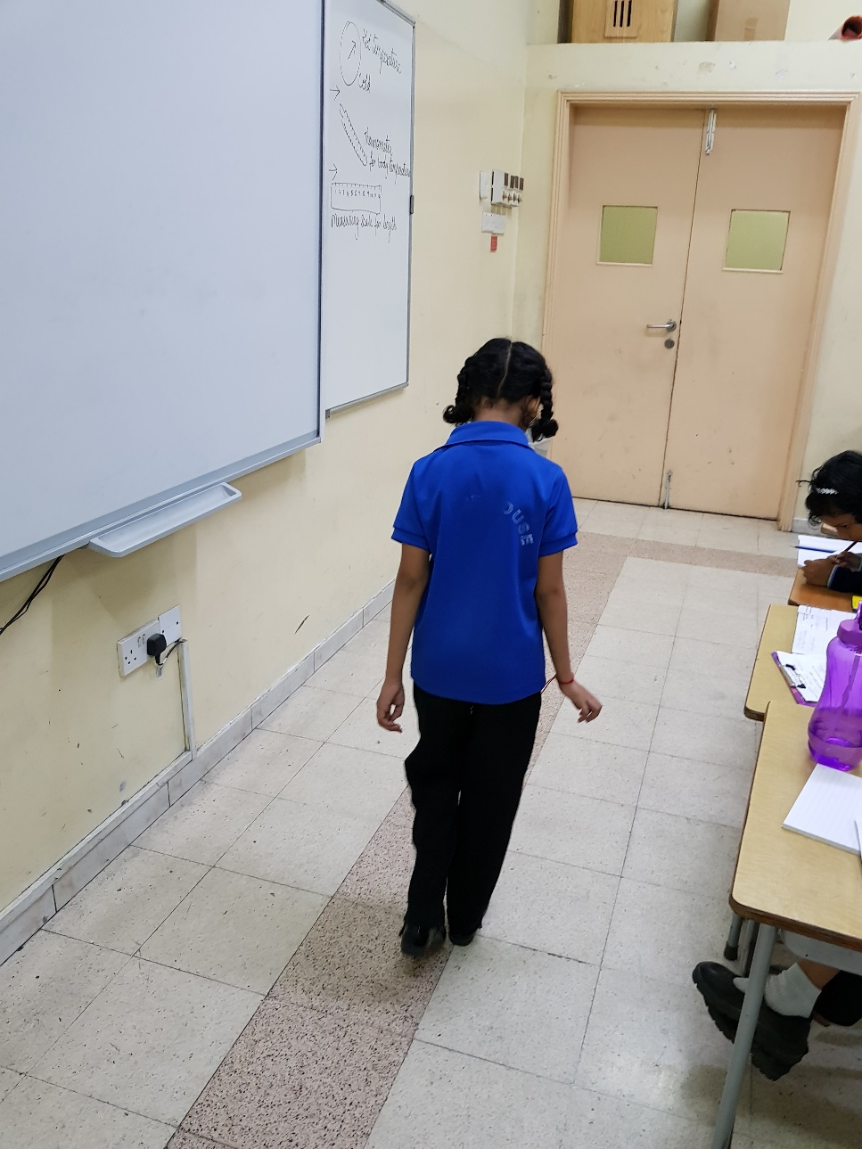

Slide 12
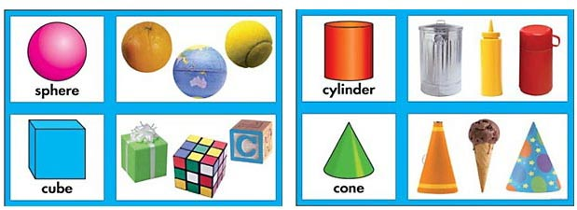
Shapes & Patterns

Slide 13
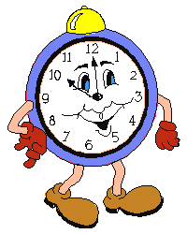
Time
Half Past 10
or
10:30

Slide 14
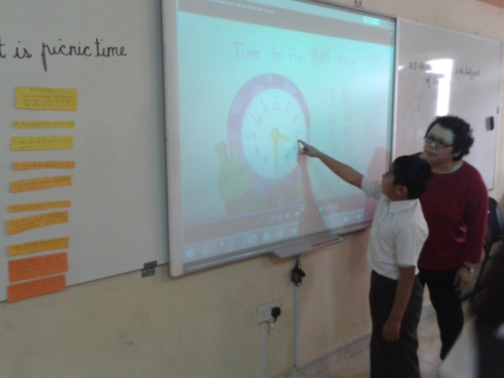

Slide 15
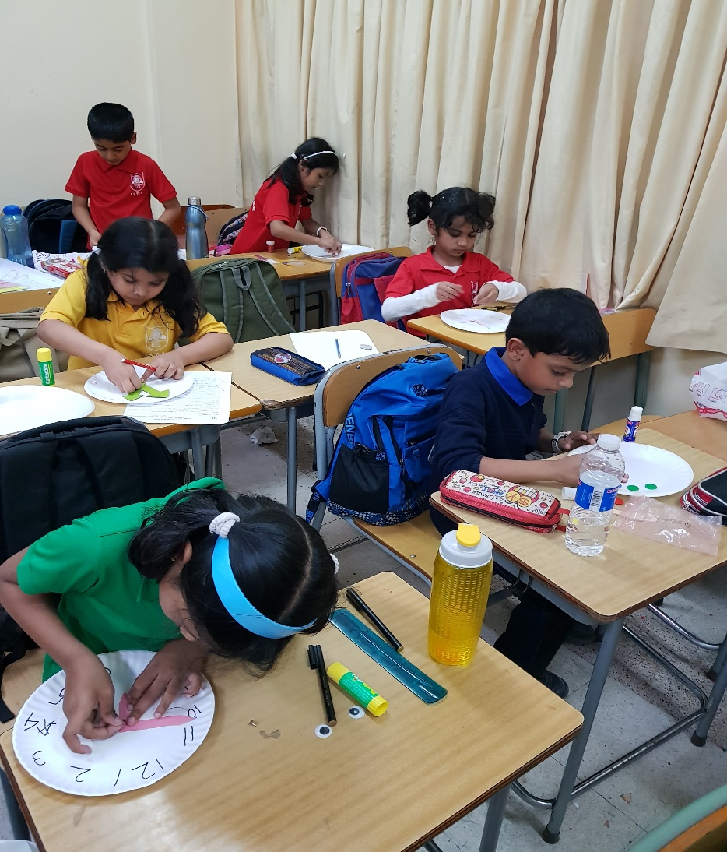
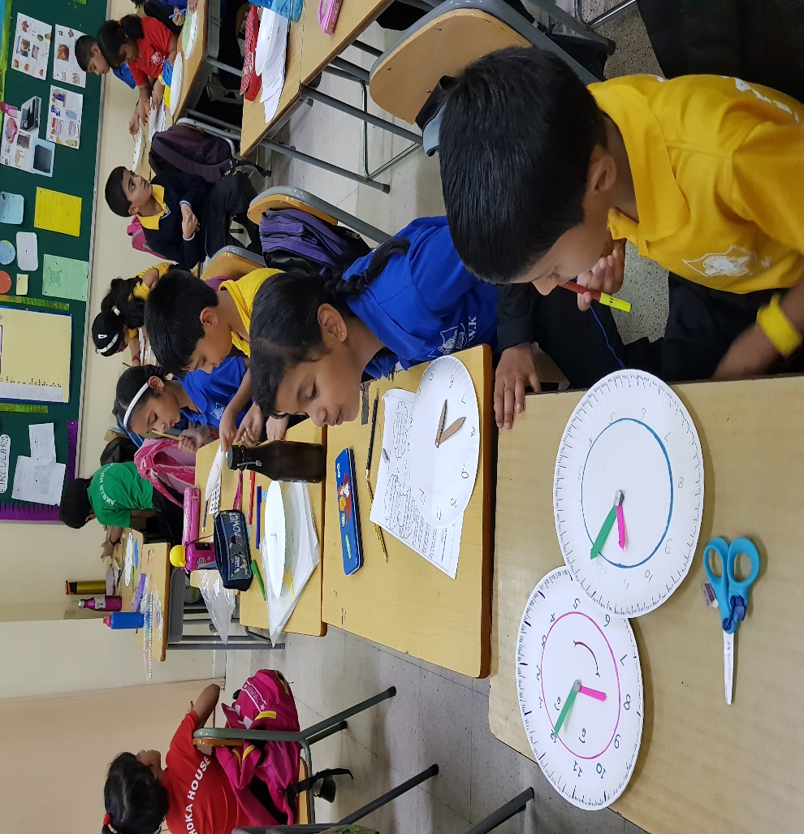

Slide 16
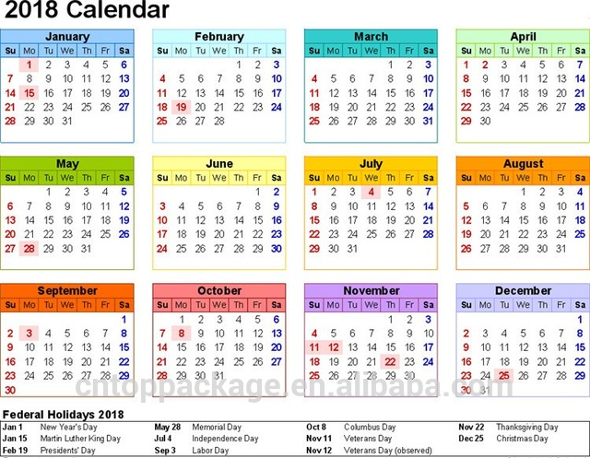
Calendar

Slide 17
Money
Omani Rial
OMR

Slide 18
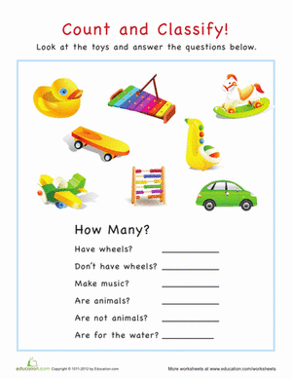
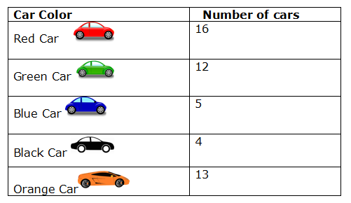
Data Handling

Slide 19
STRATEGIES FOLLOWED
WHITEBOARD/ SMART BOARD DRILL
MATH LAB ACTIVITIES
GROUP ACTIVITIES
GAMES
AUDIO VISUAL AIDS
WORKSHEETS

Slide 20
