Slide 1
PRIMARY
COUNSELLING
&
SPECIAL EDUCATION
DEPARTMENT

Slide 2
AREAS
BEHAVIOURAL
DIFFERENCES
ACADEMIC
PERFORMANCE
DIFFICULTIES
DEVELOPMENTAL
DELAYS

Slide 3
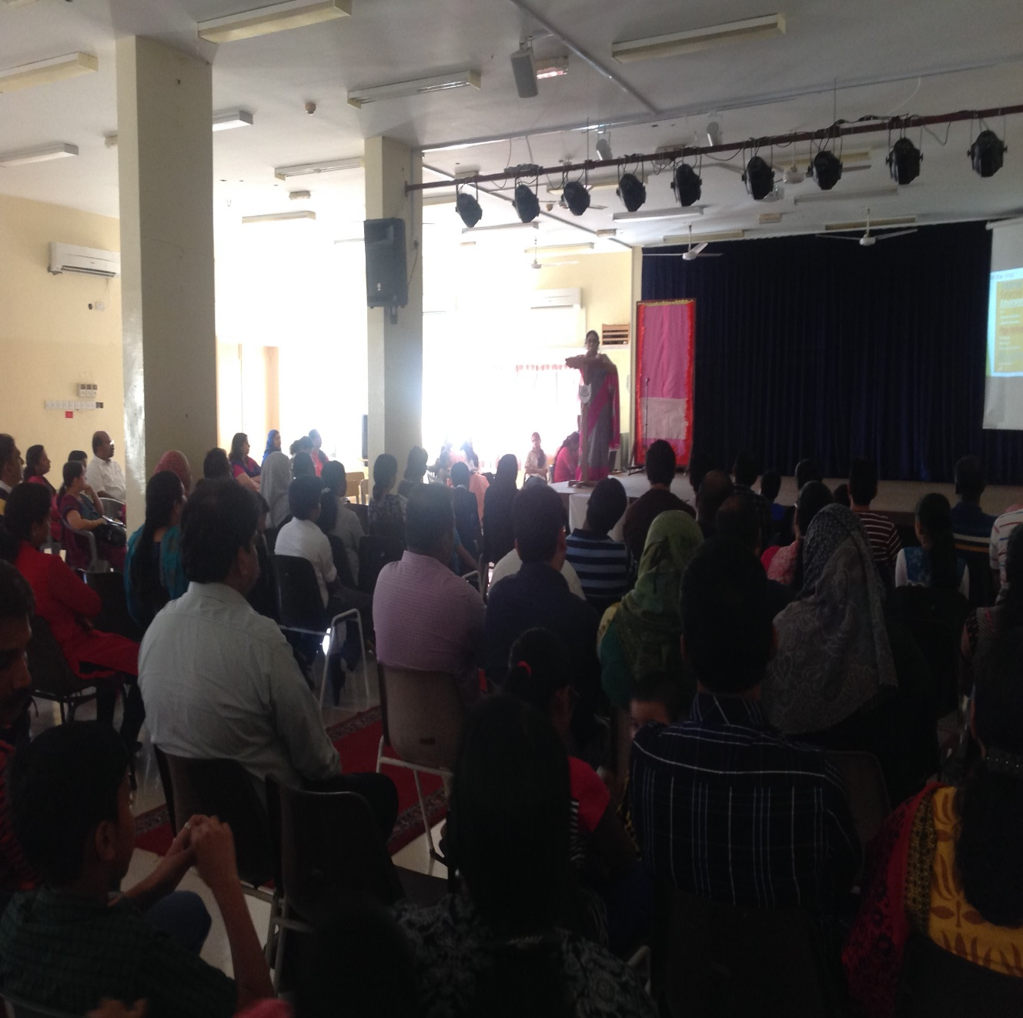
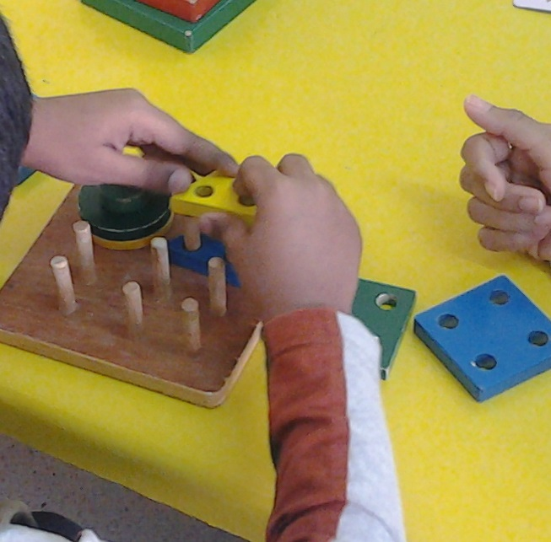
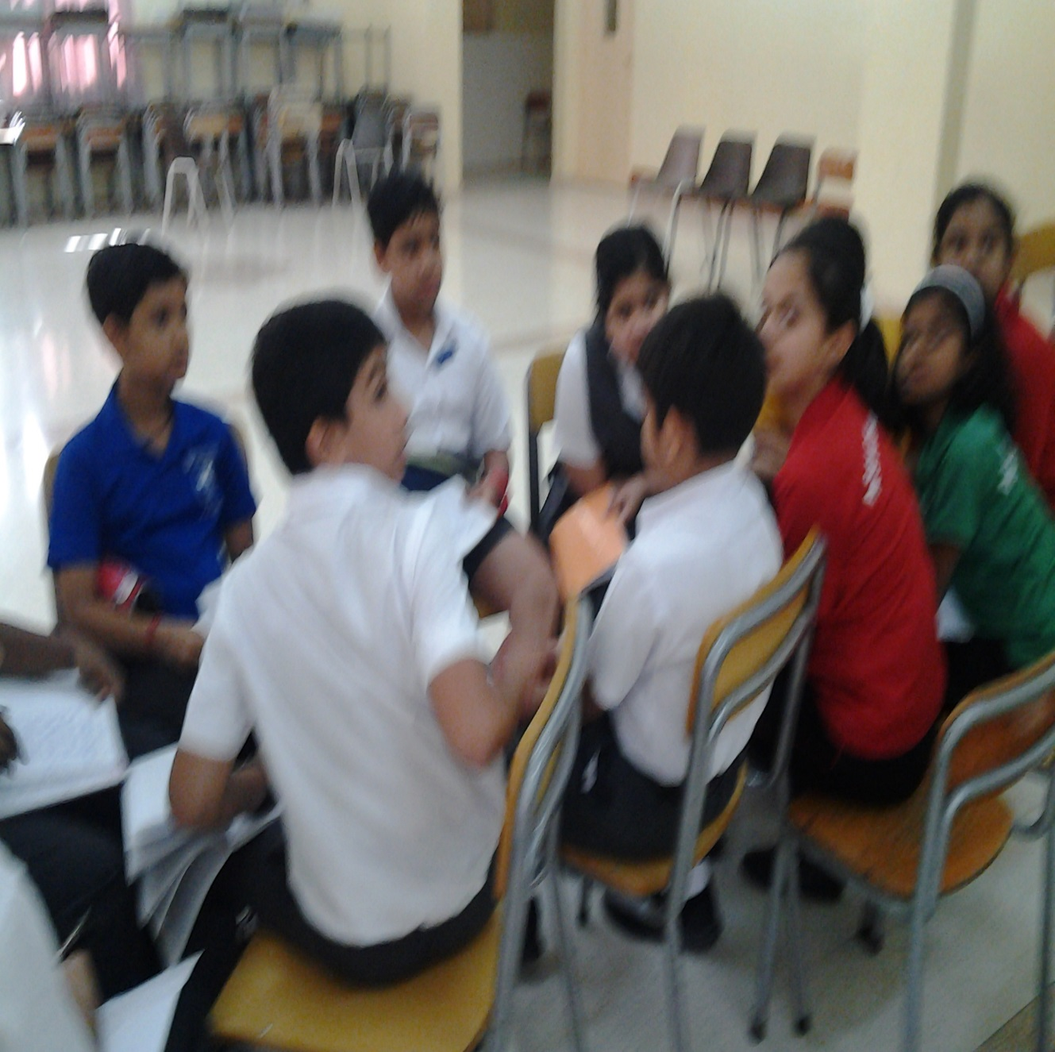
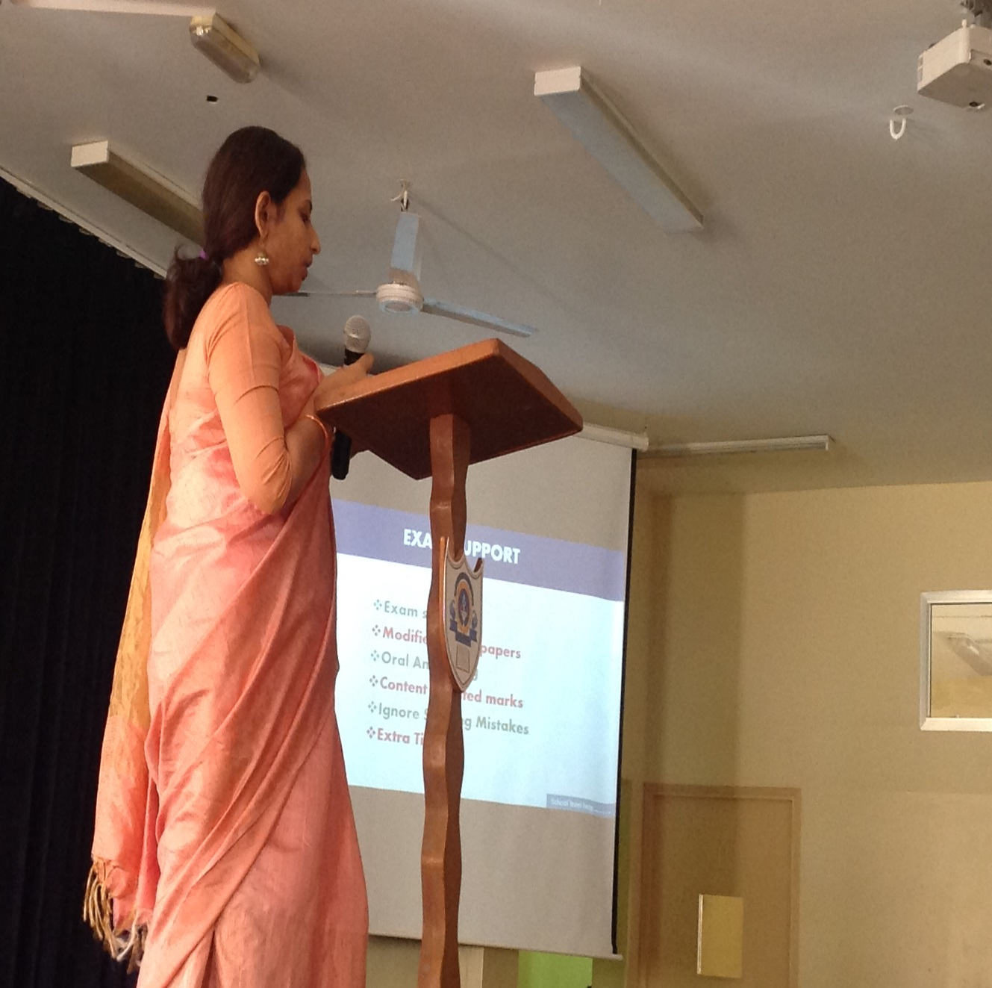
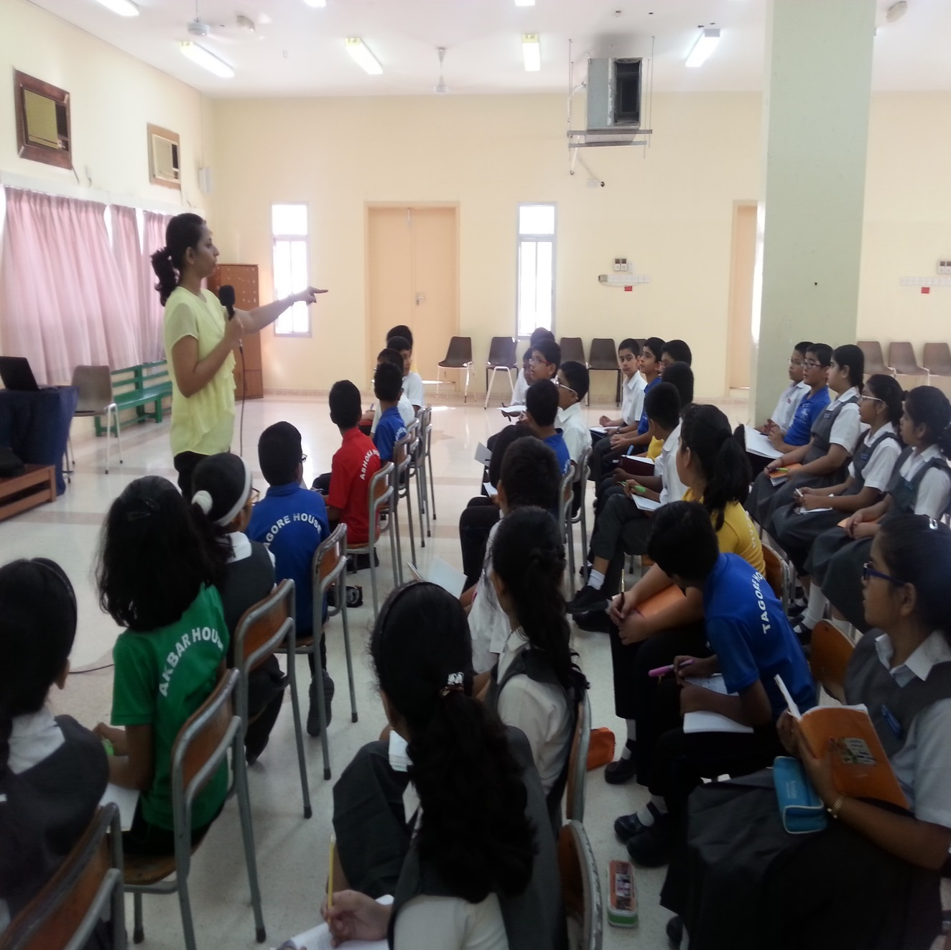
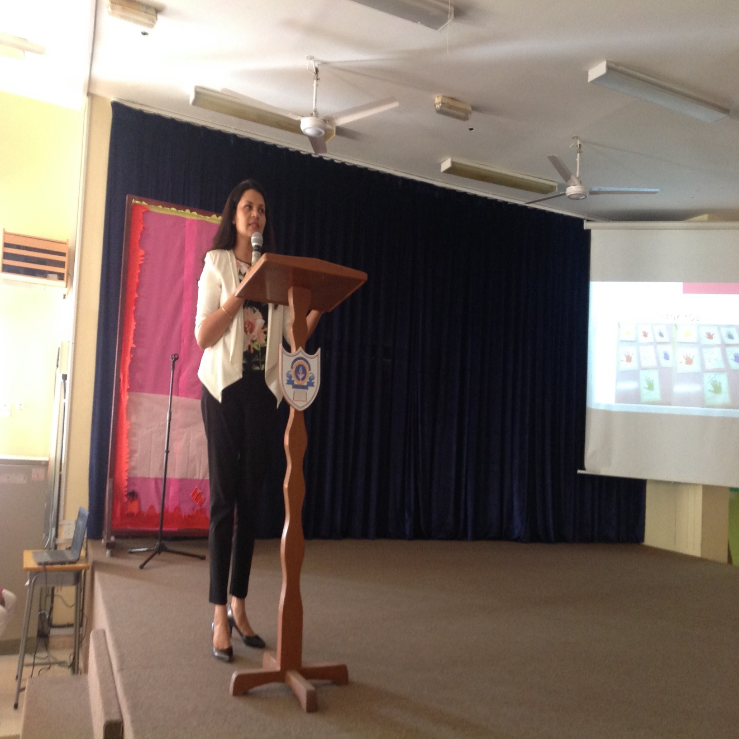
SERVICES
Counselling & Guidance
Informal Assessments
Identifying Special needs
External References
Special Education
Workshops & Awareness programs

Slide 4
Sen student Support Services
Remedial interventions
Exam Shadow
Scribe facility
Modified Exam Papers
Evaluation Concessions
Extra time for exams
Peer Budding
Shadow Parenting

Slide 5
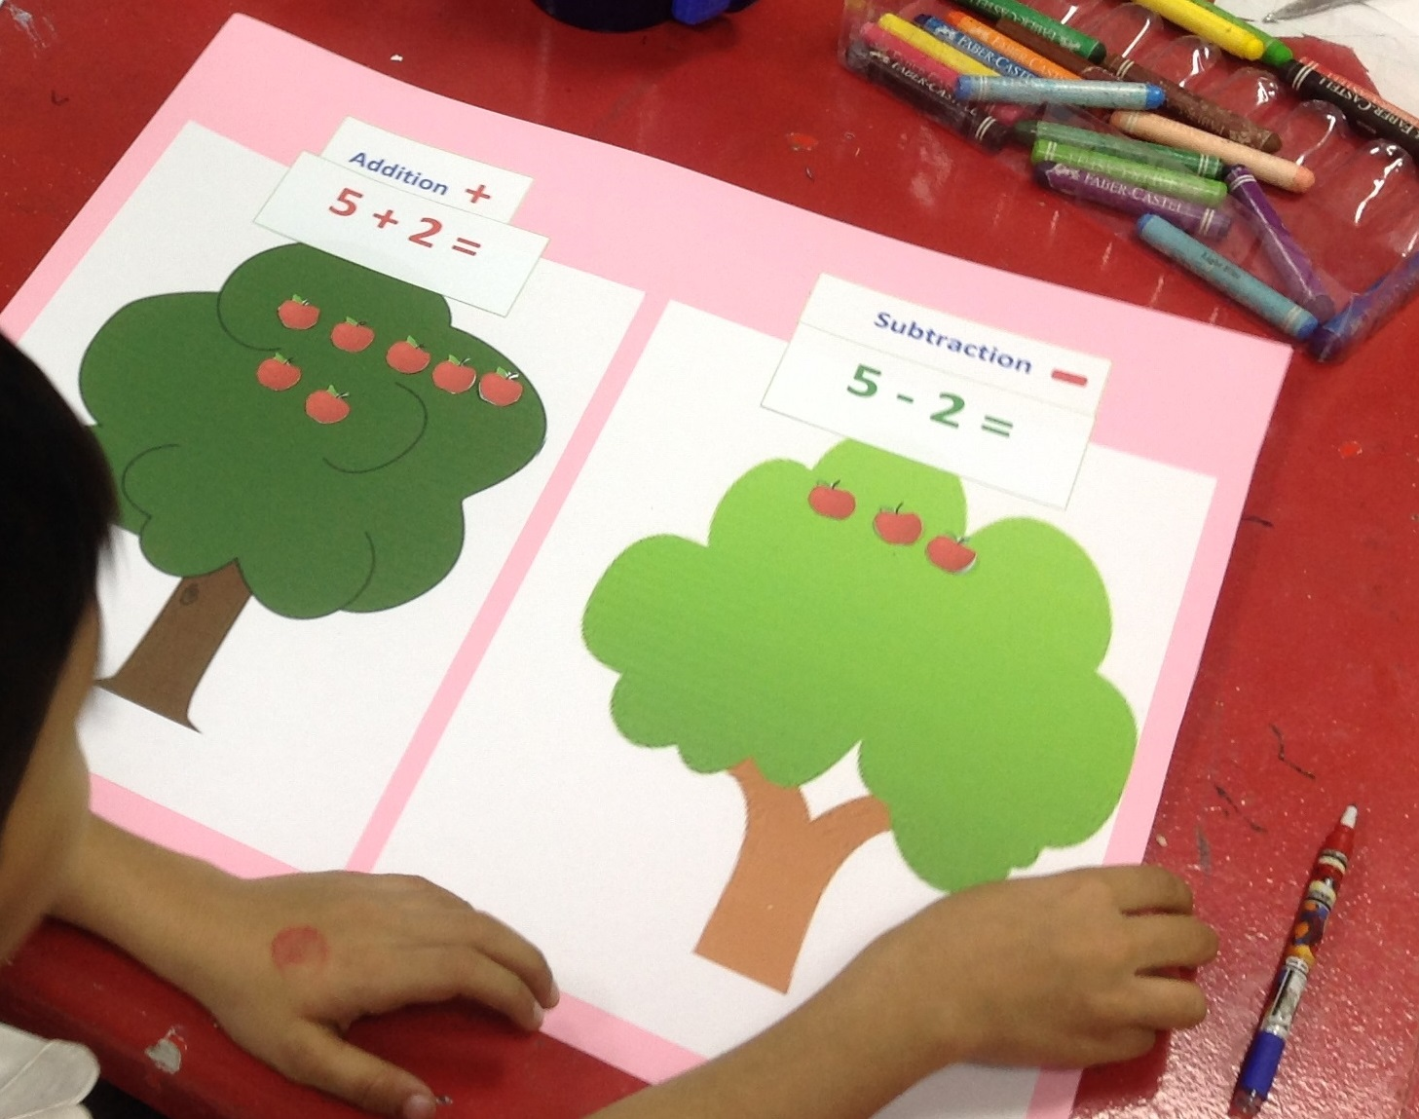
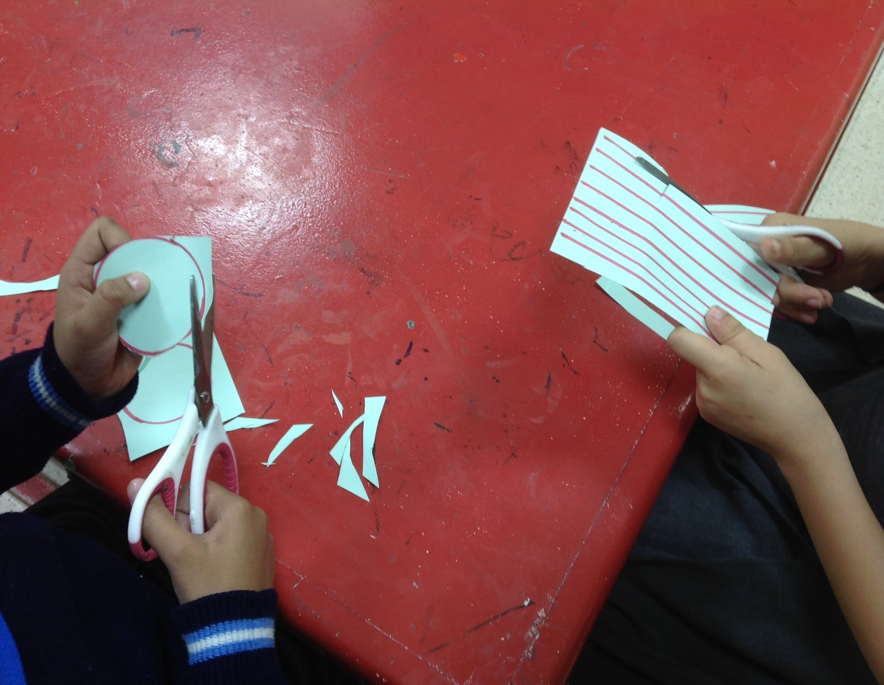
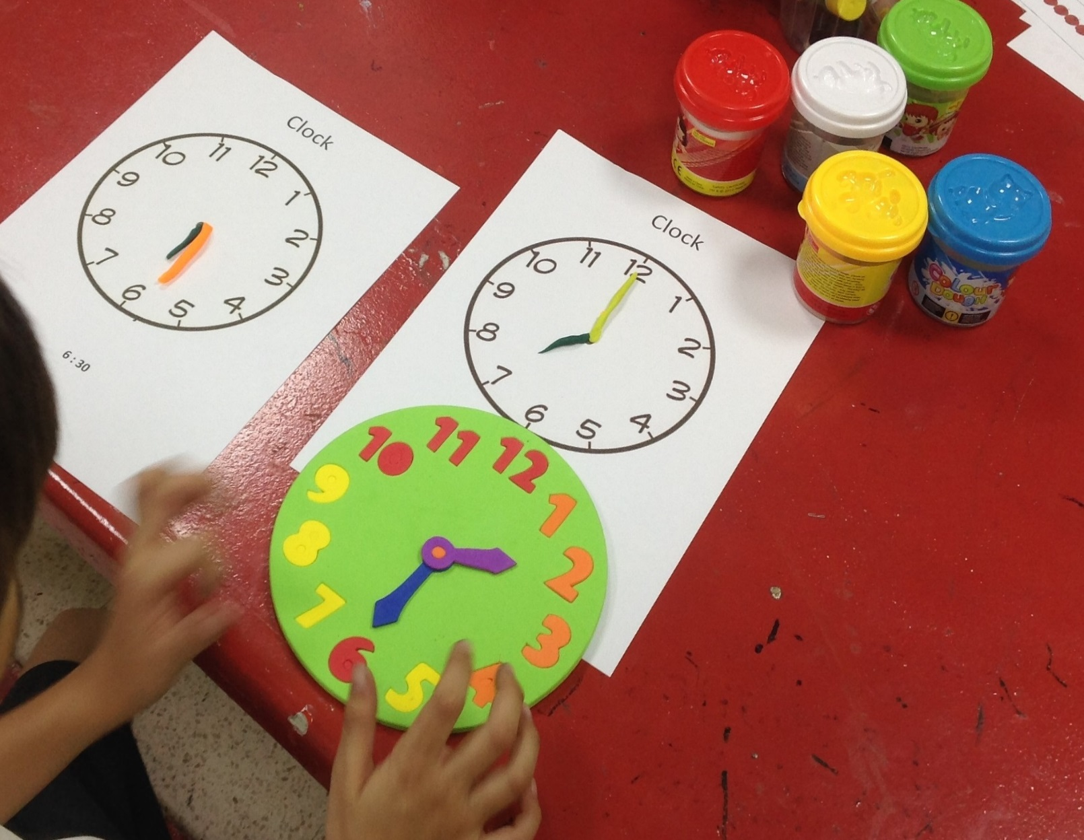
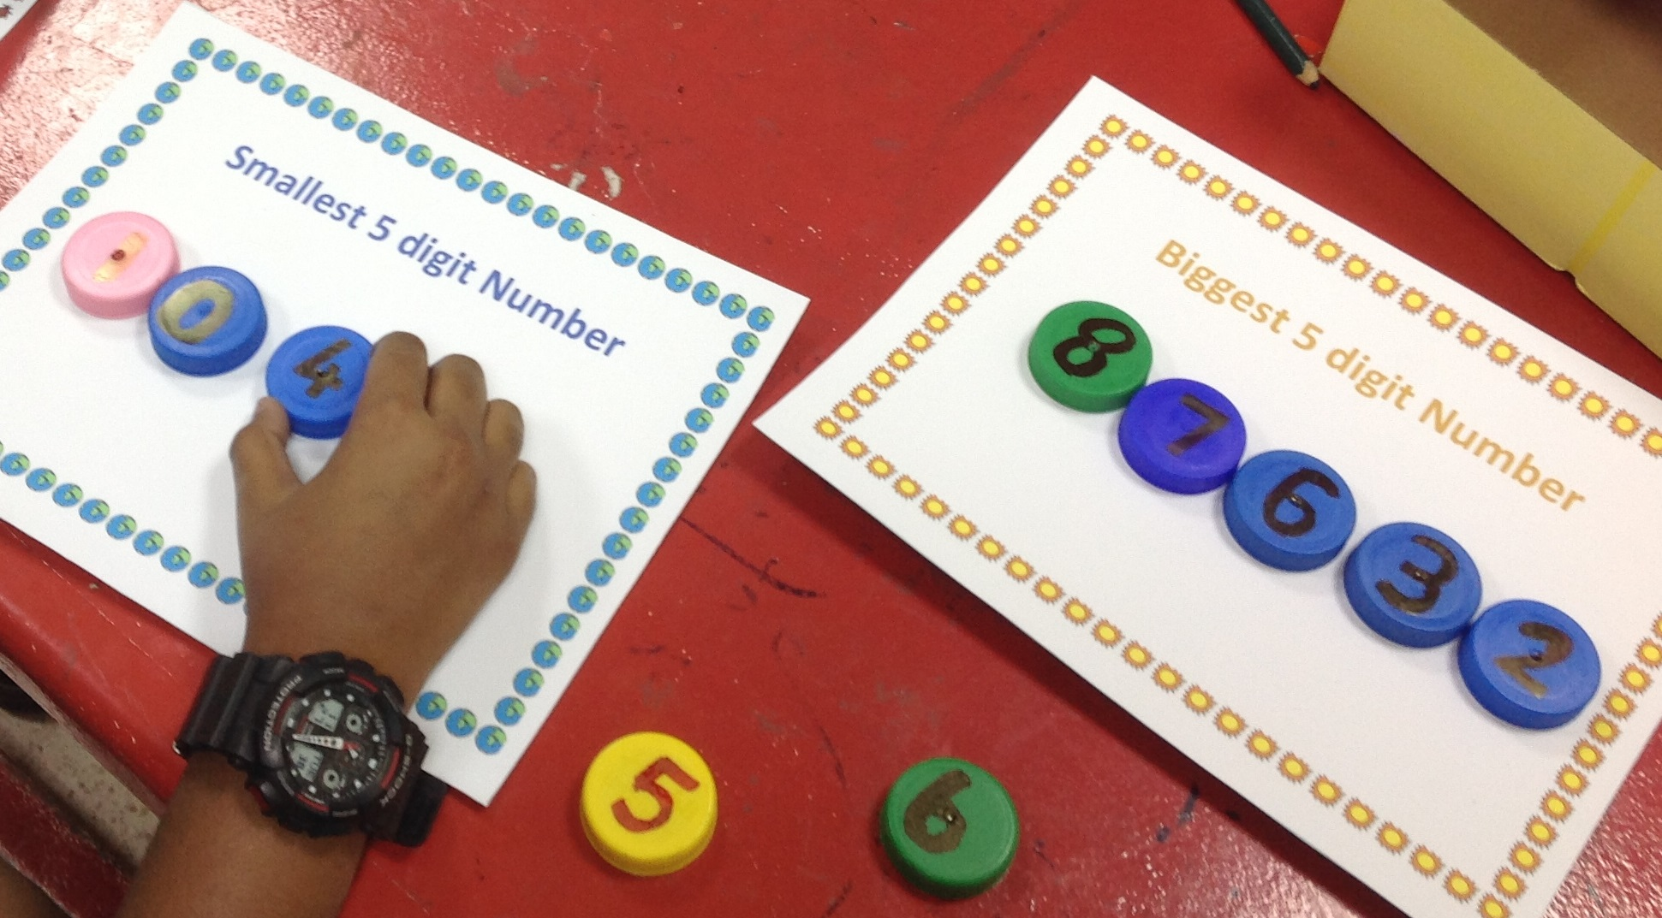
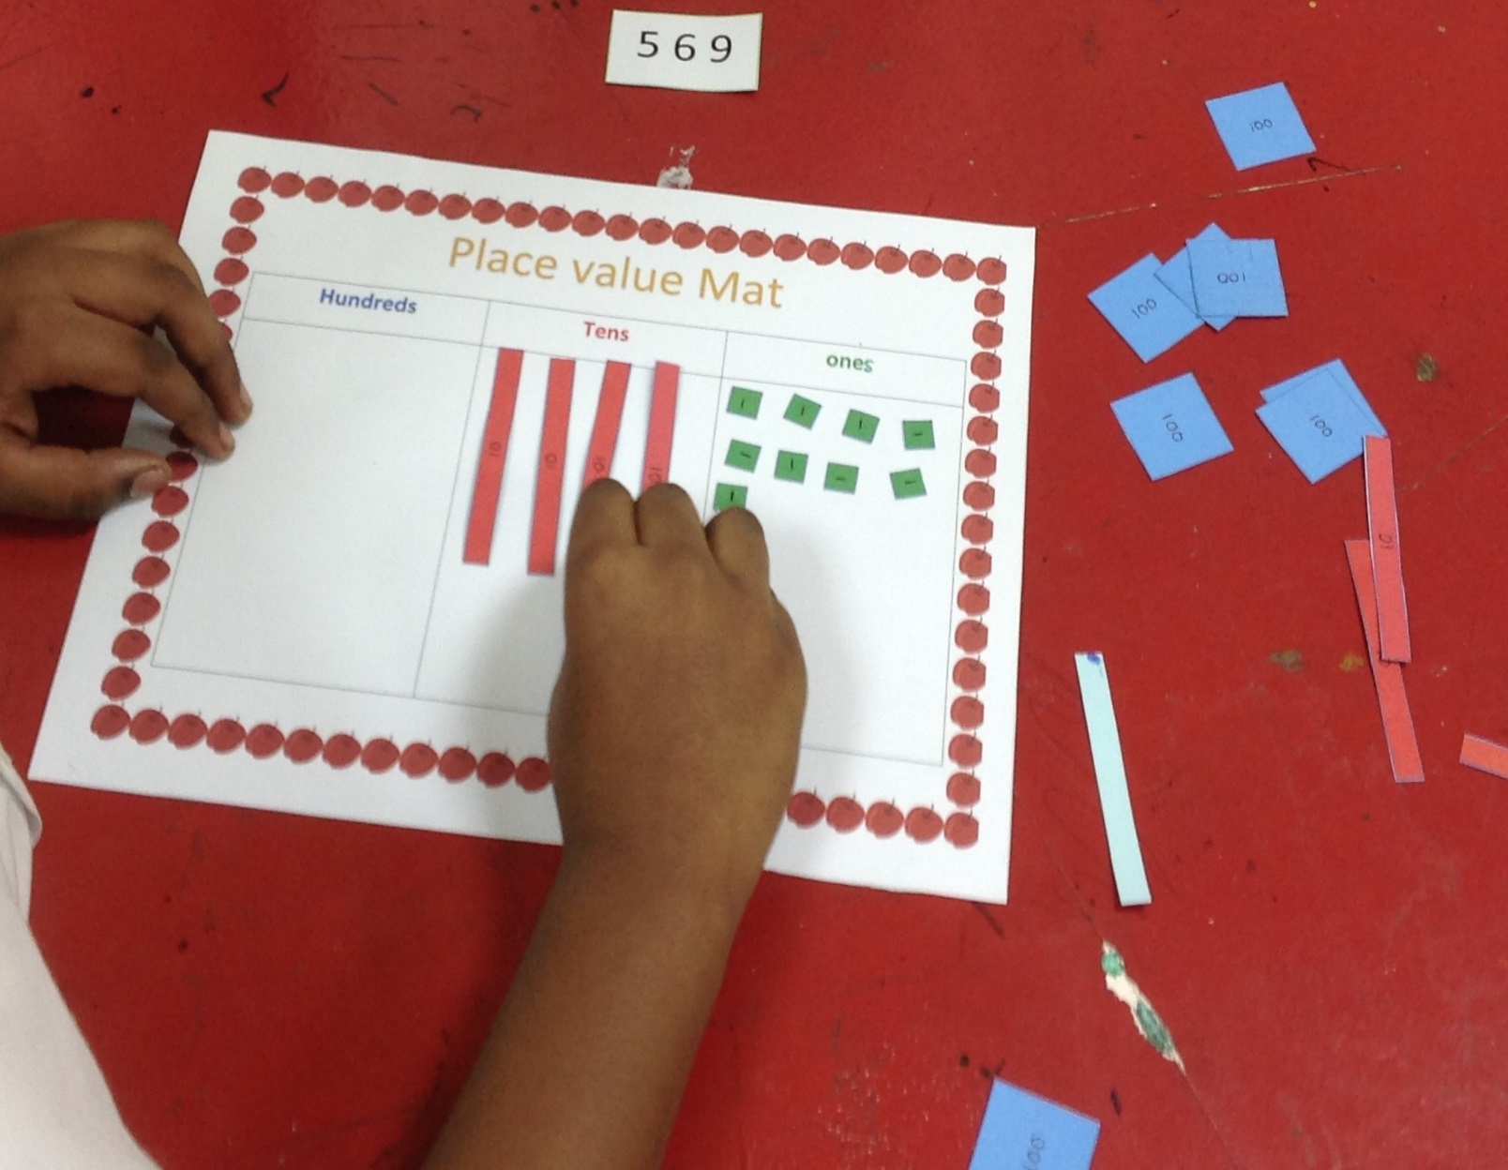
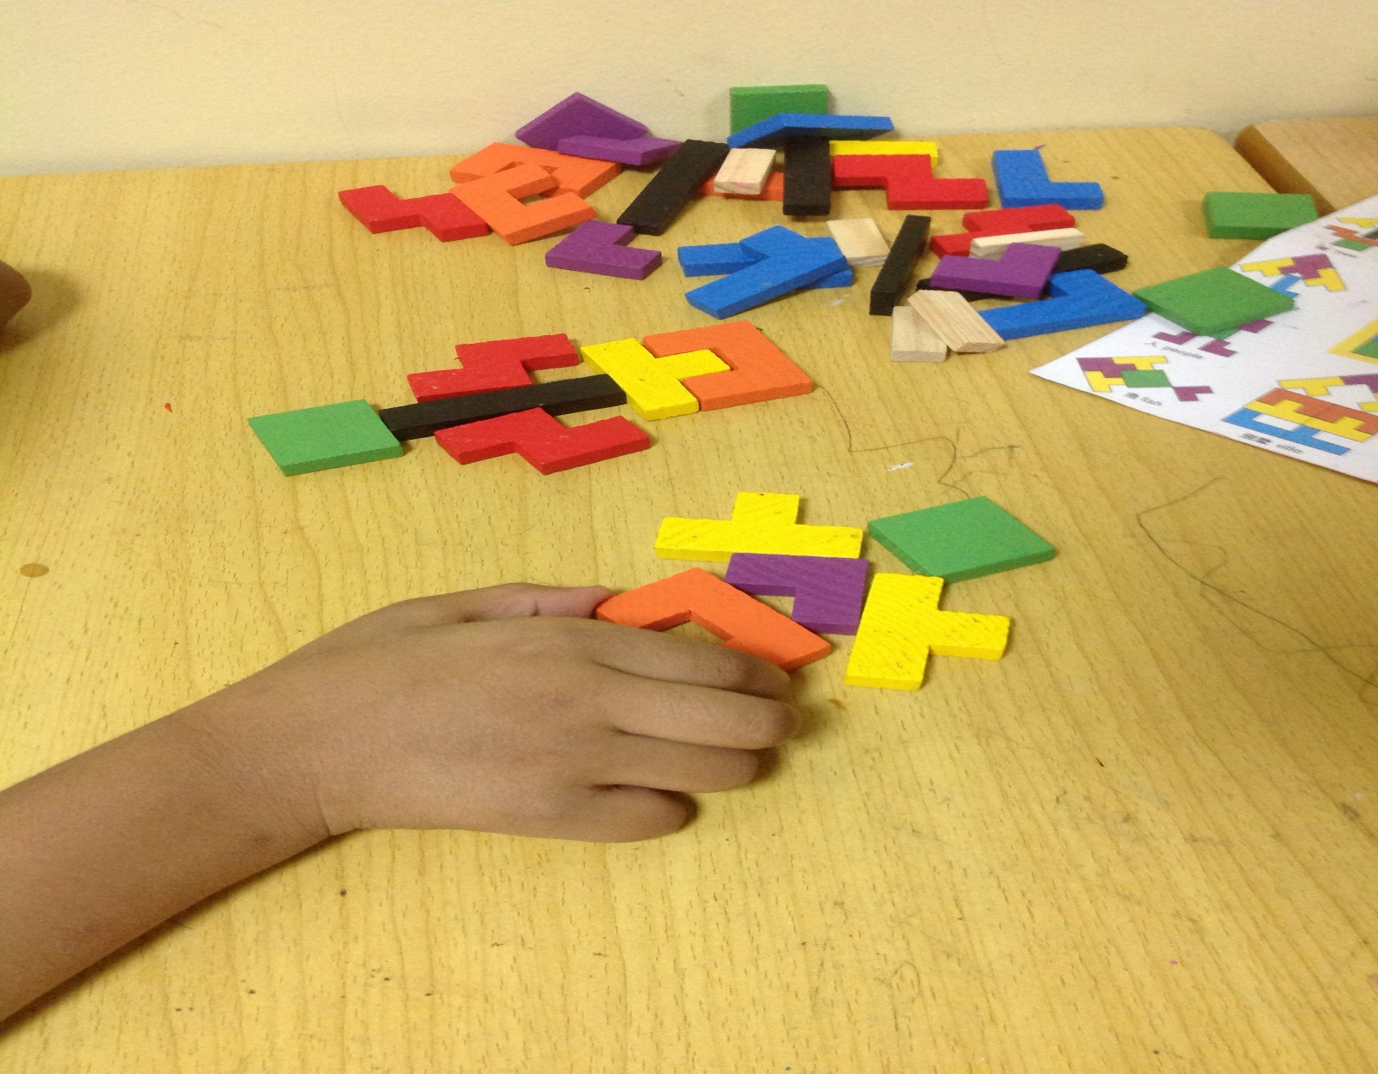
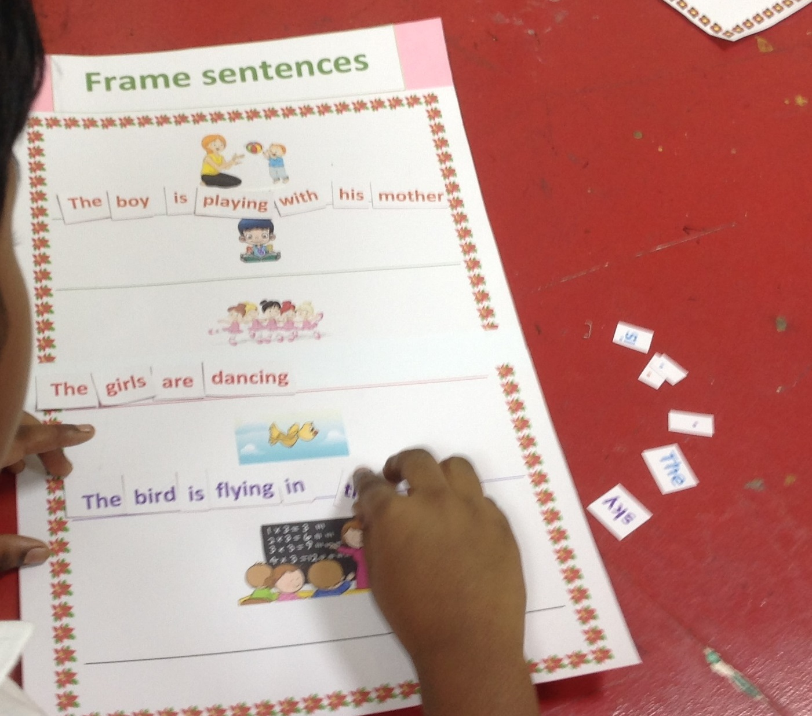
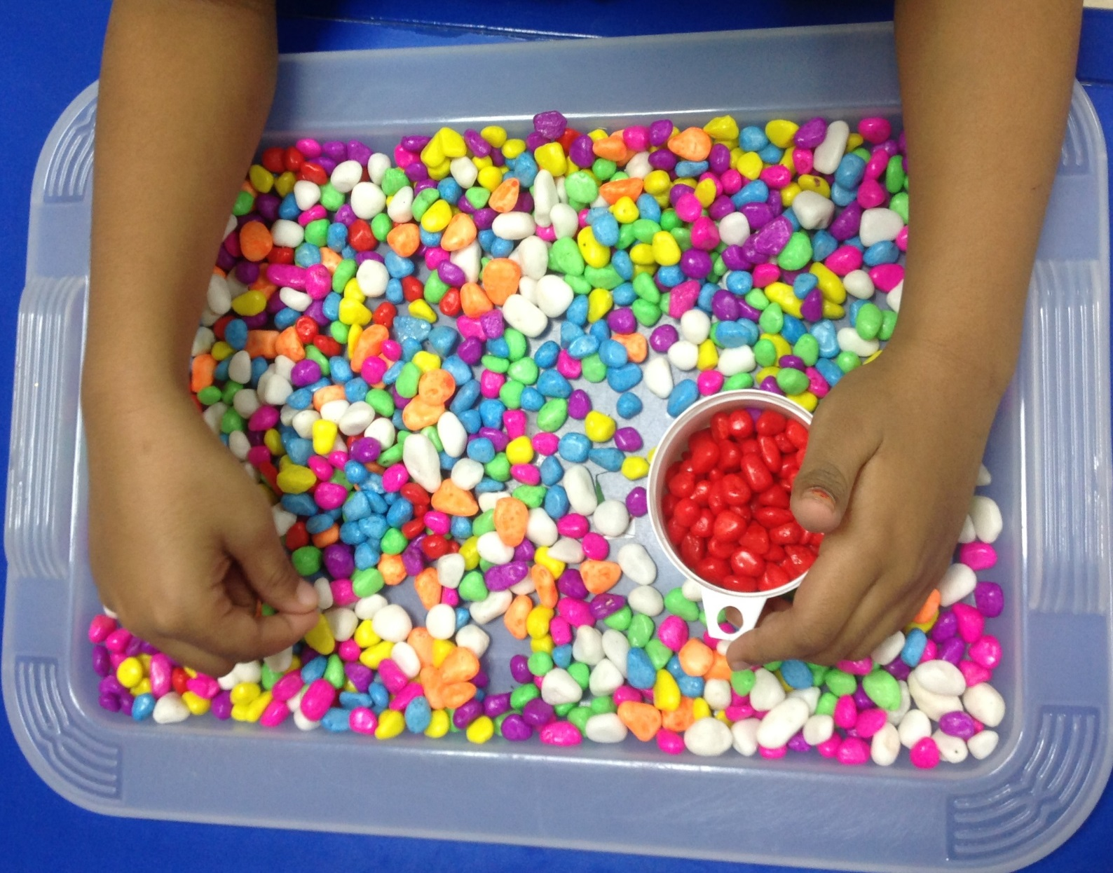
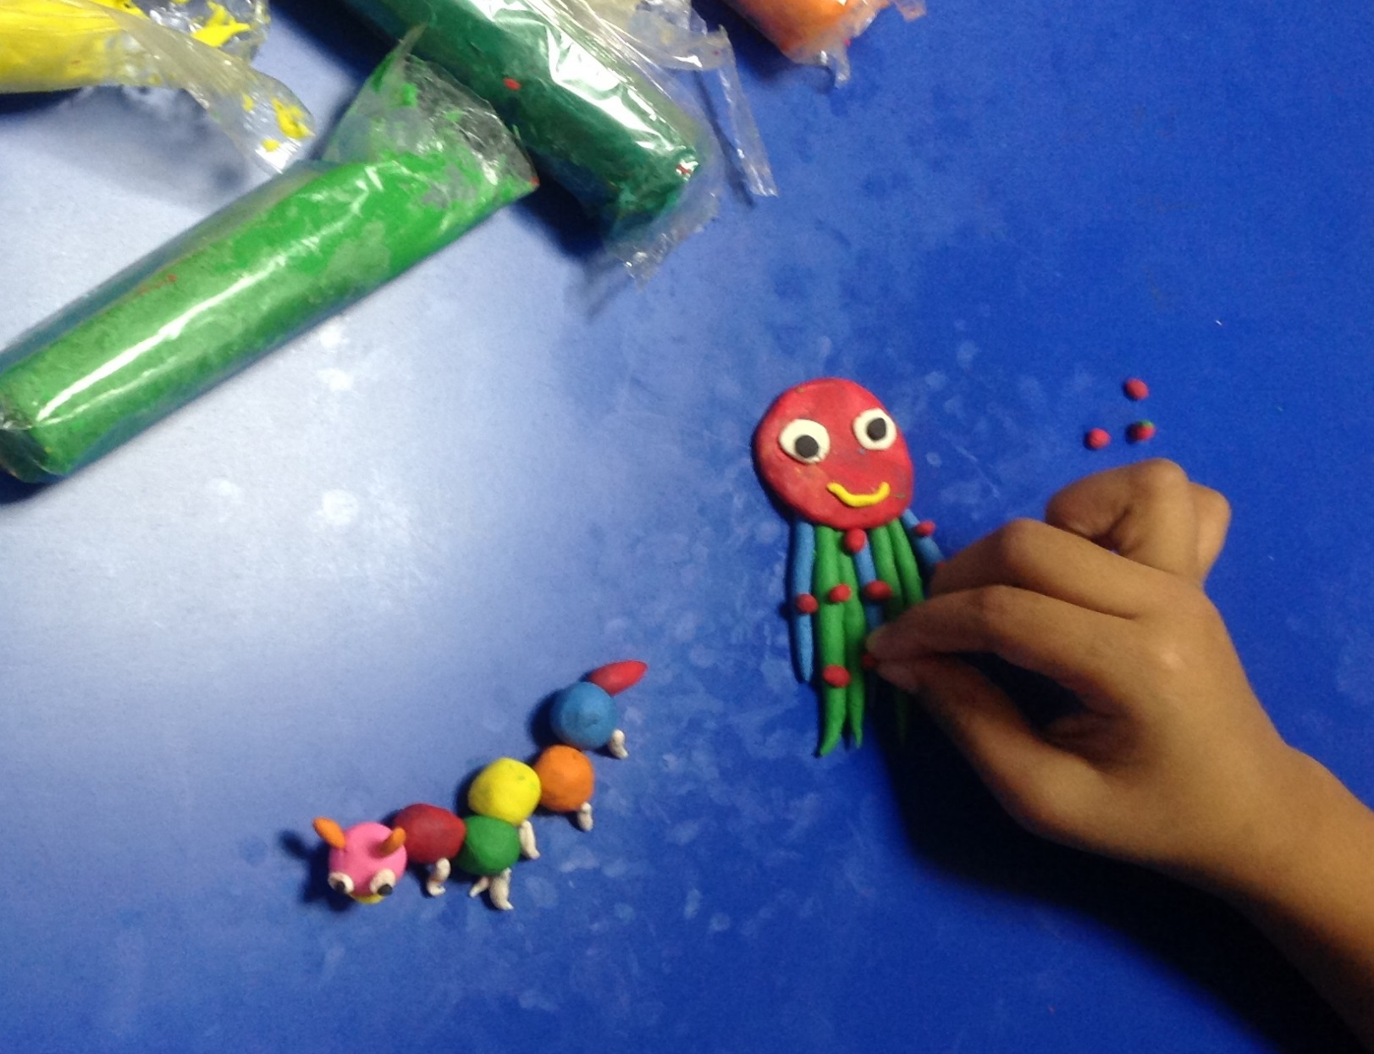
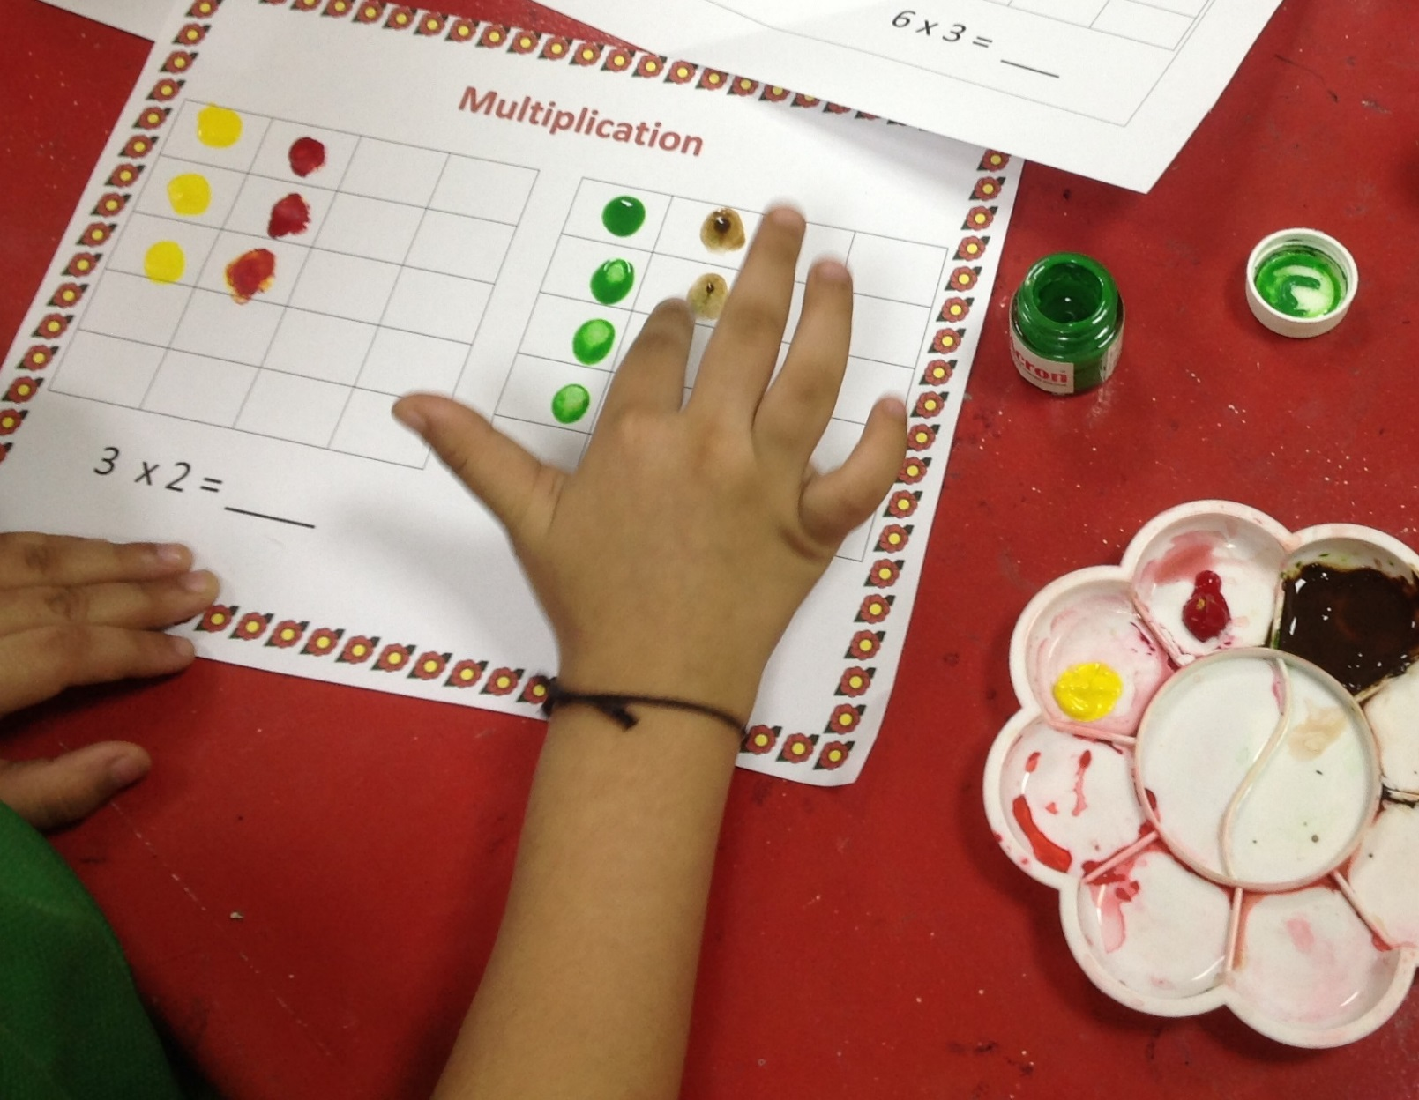
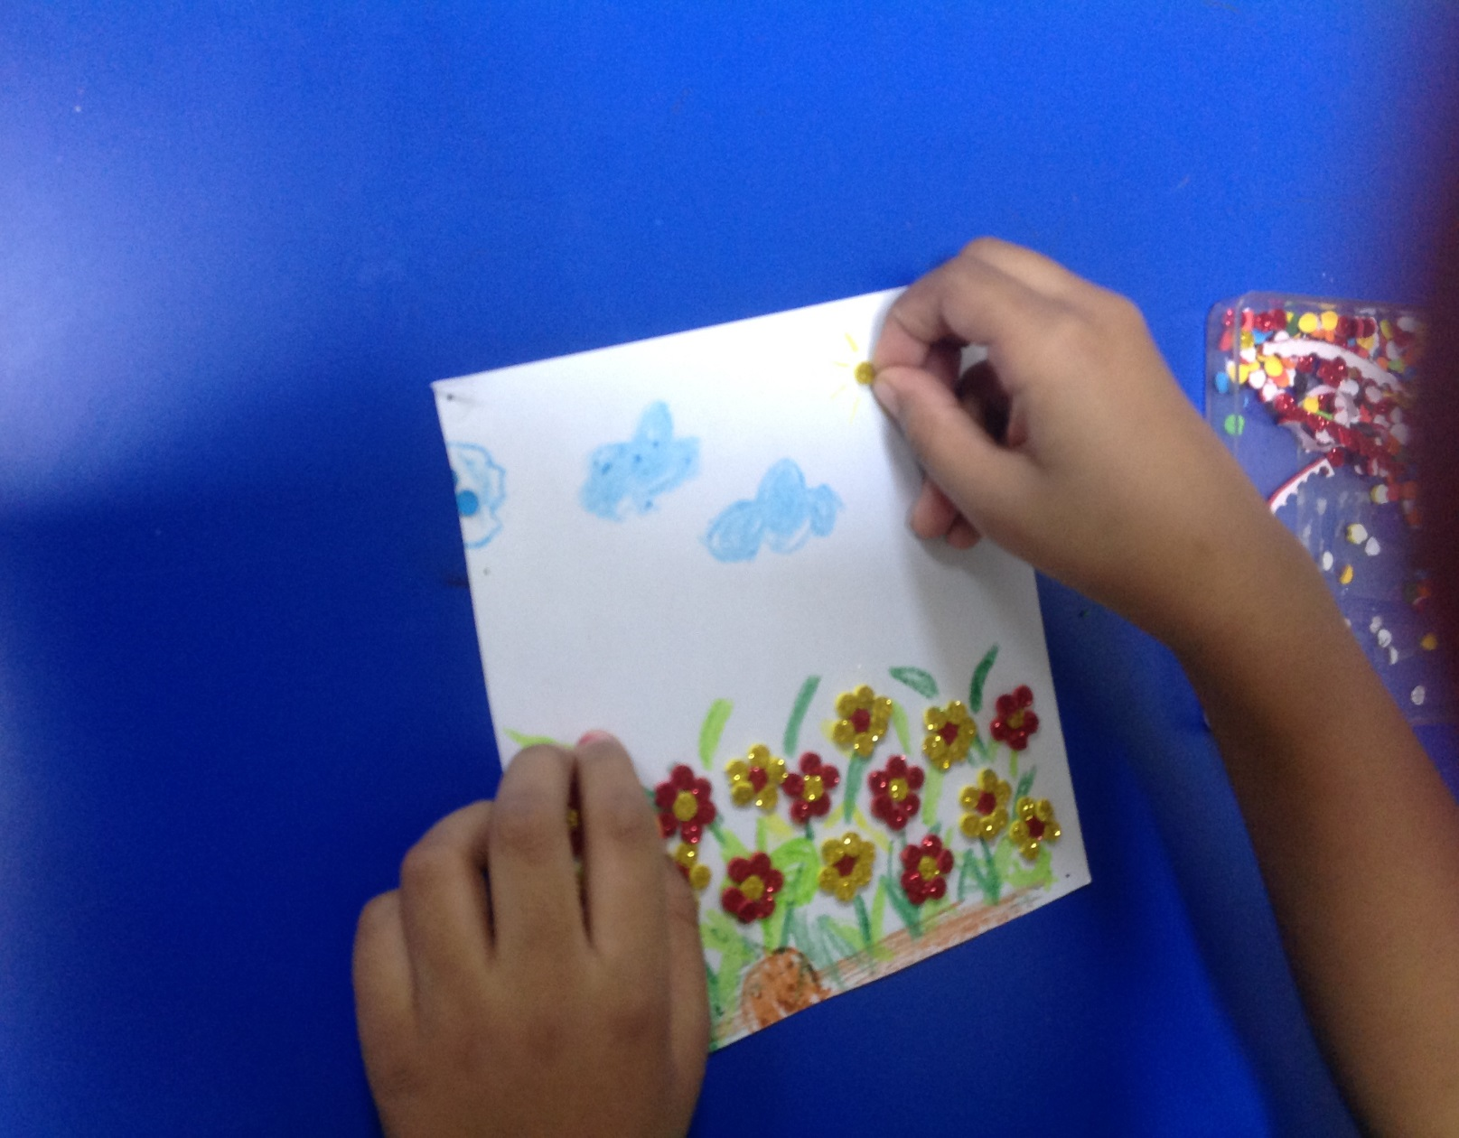
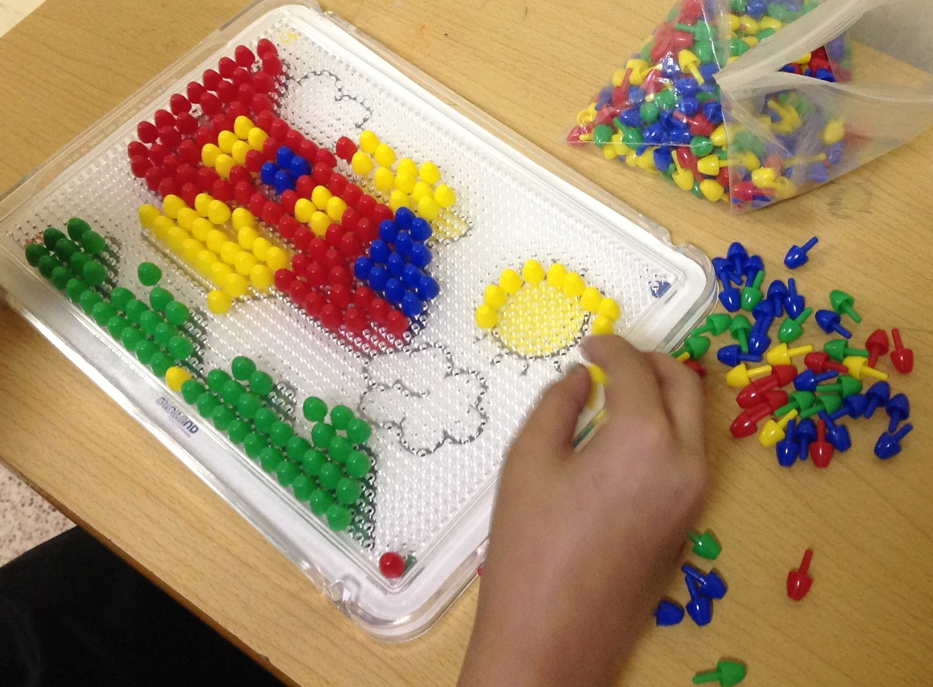
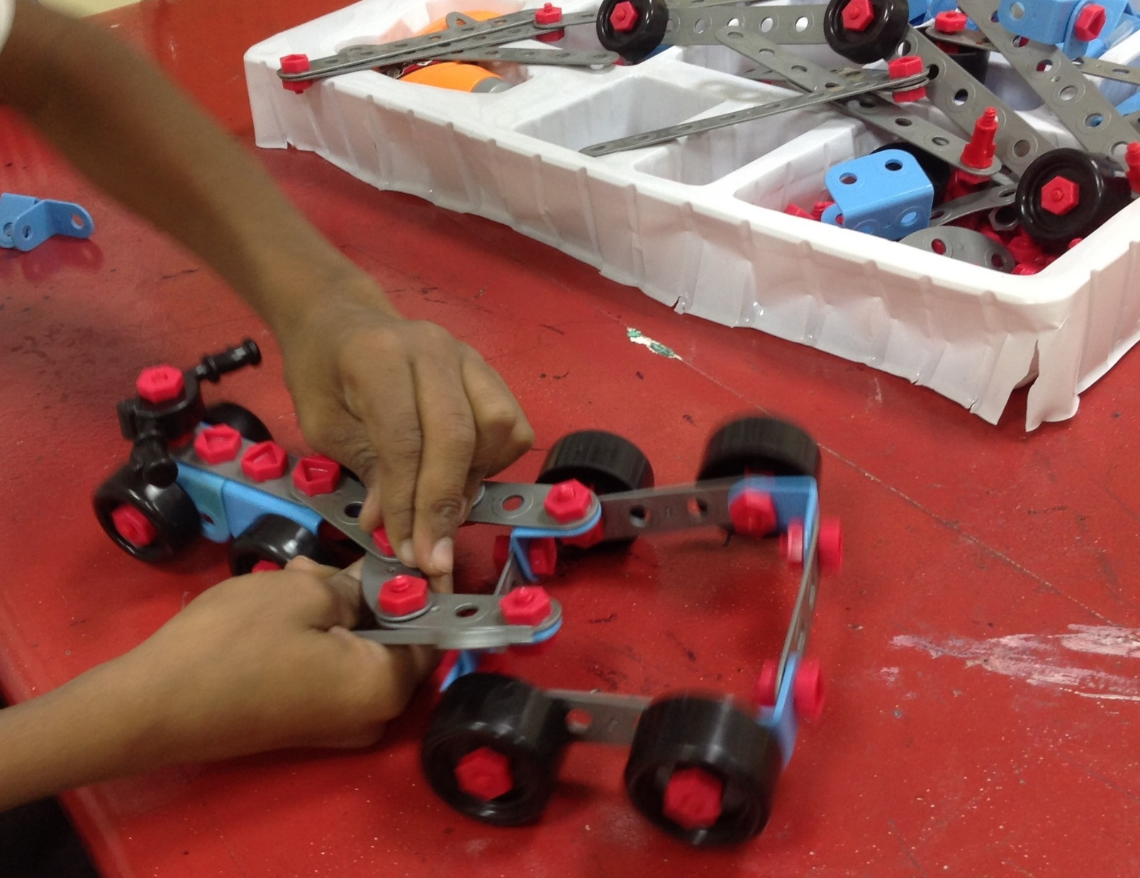
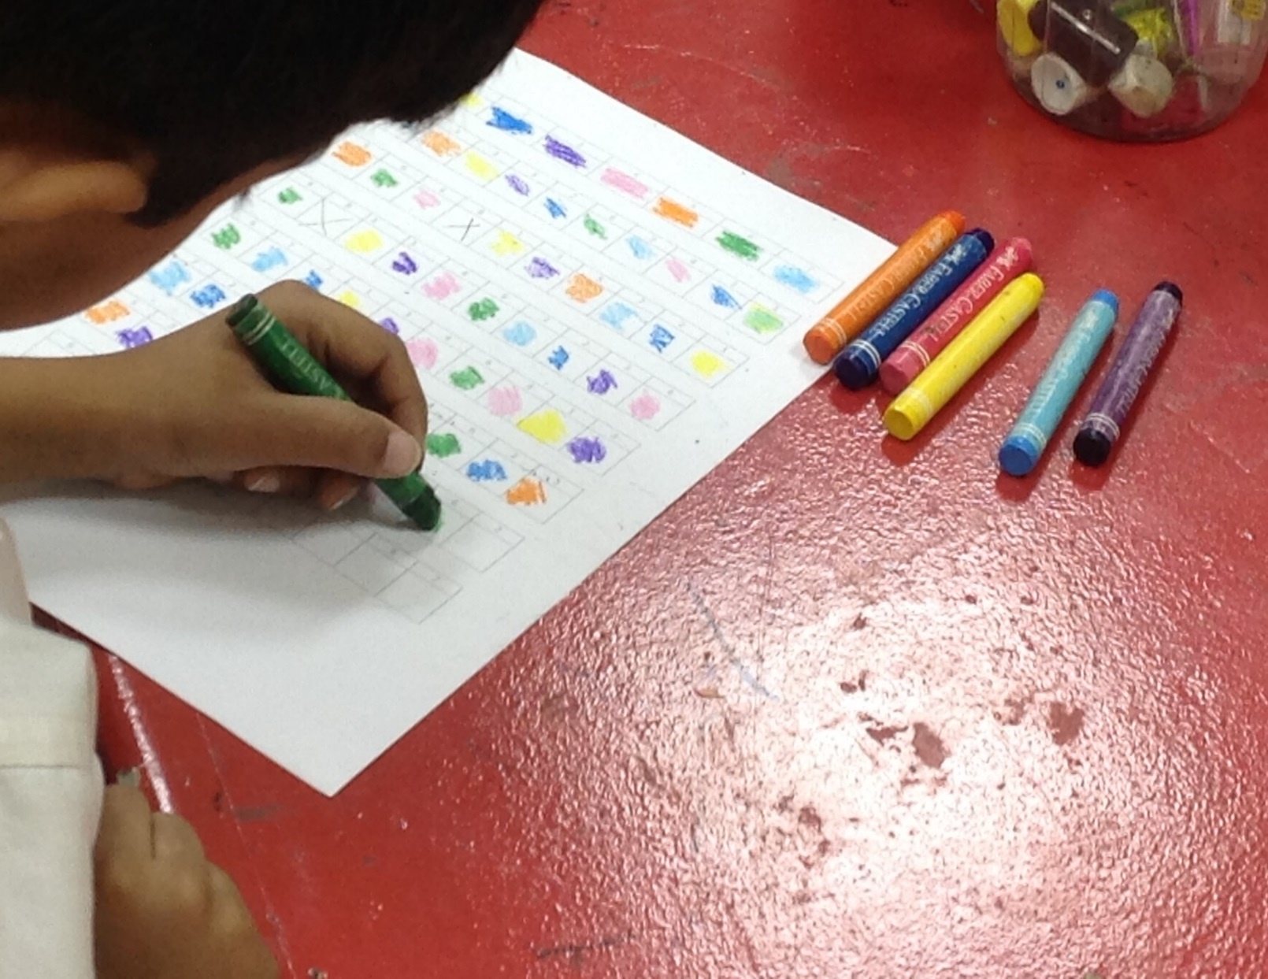
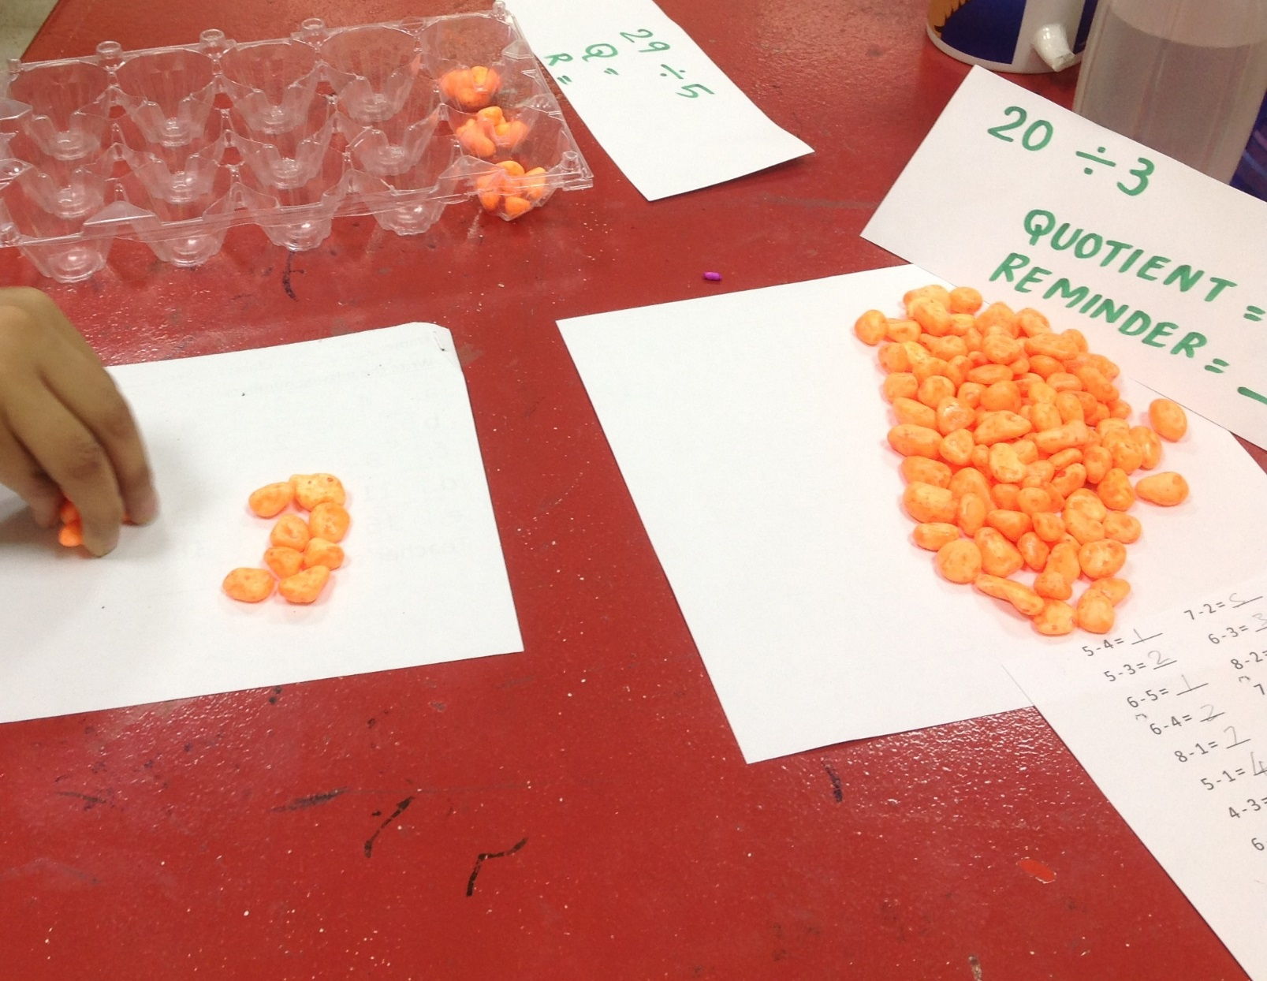
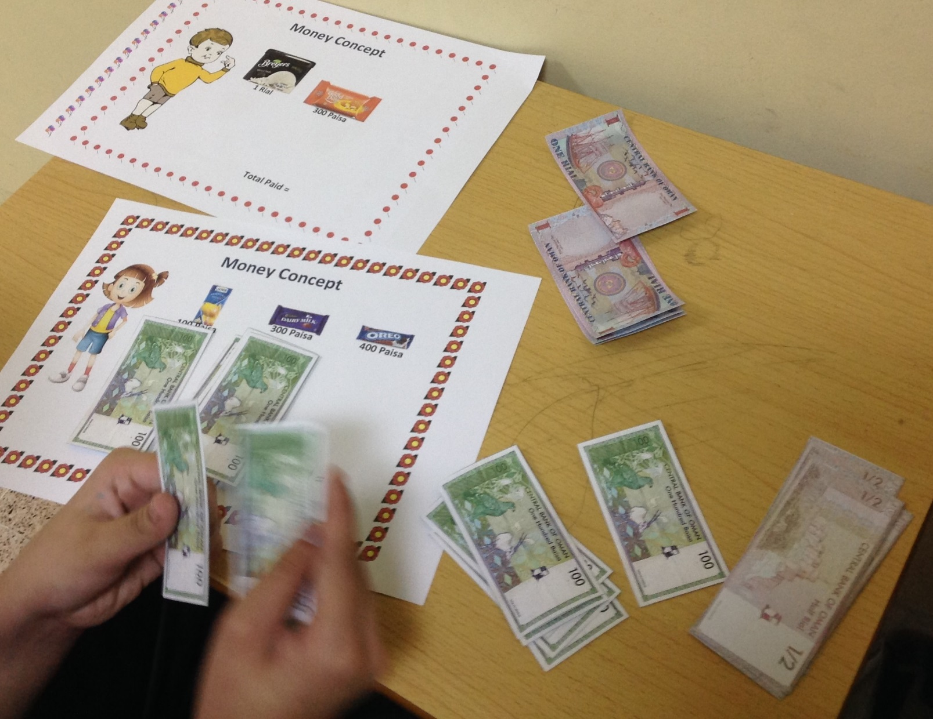
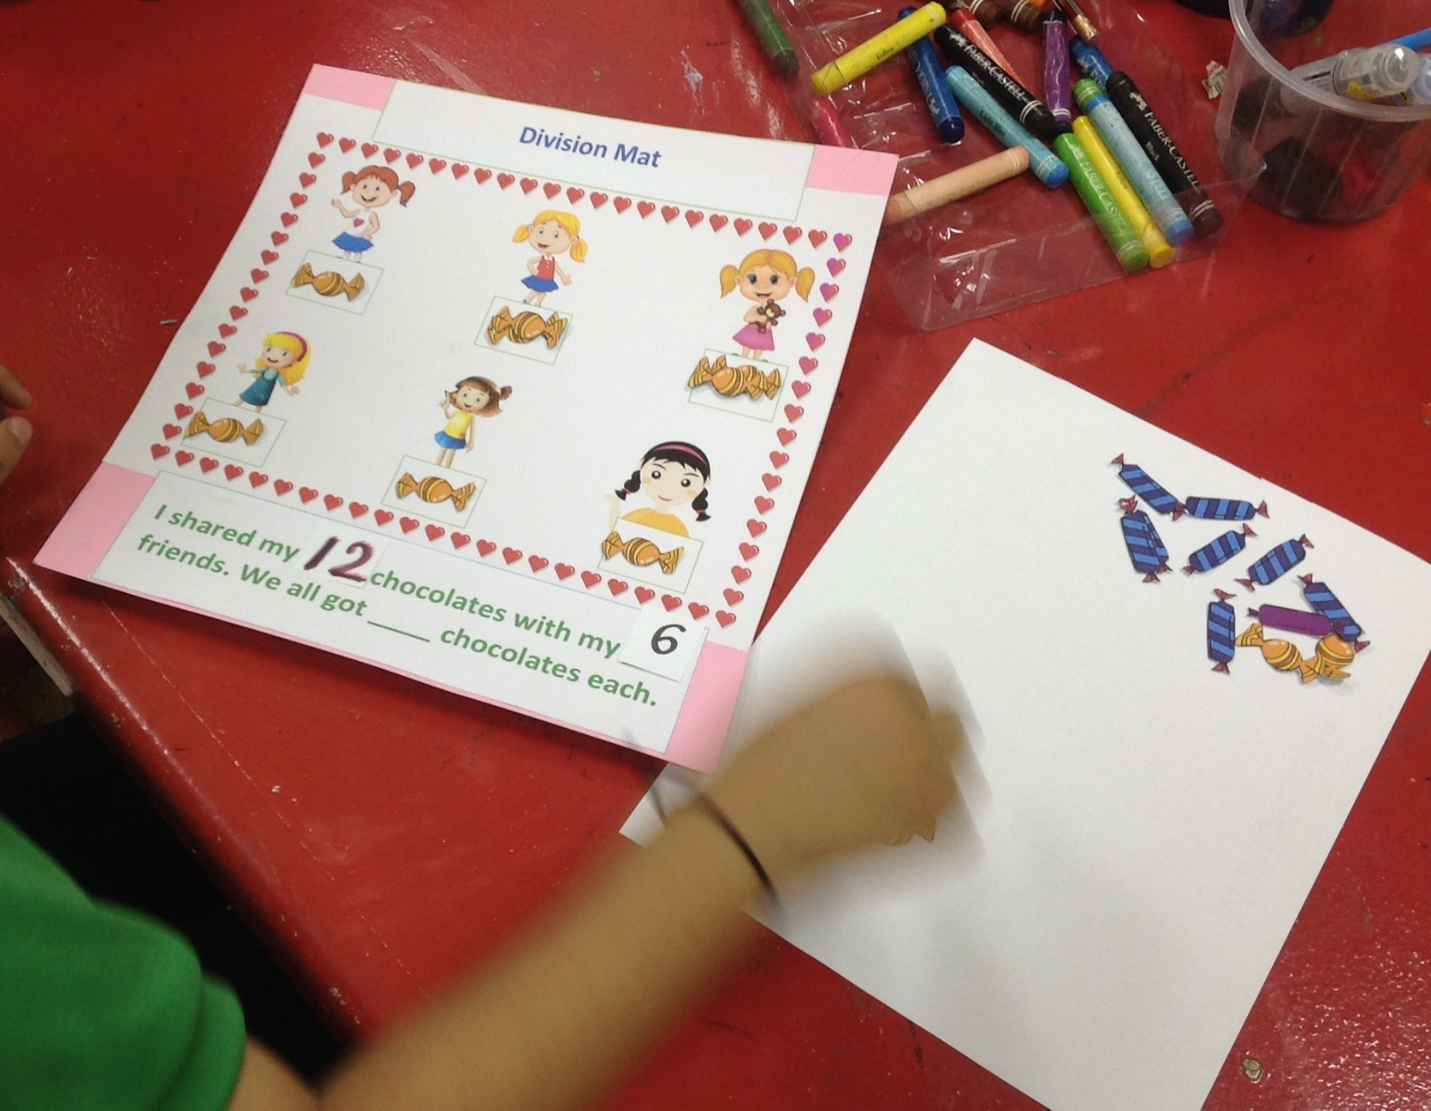
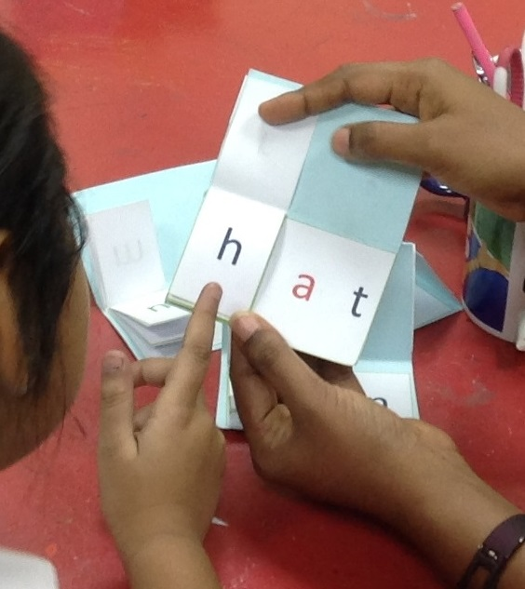
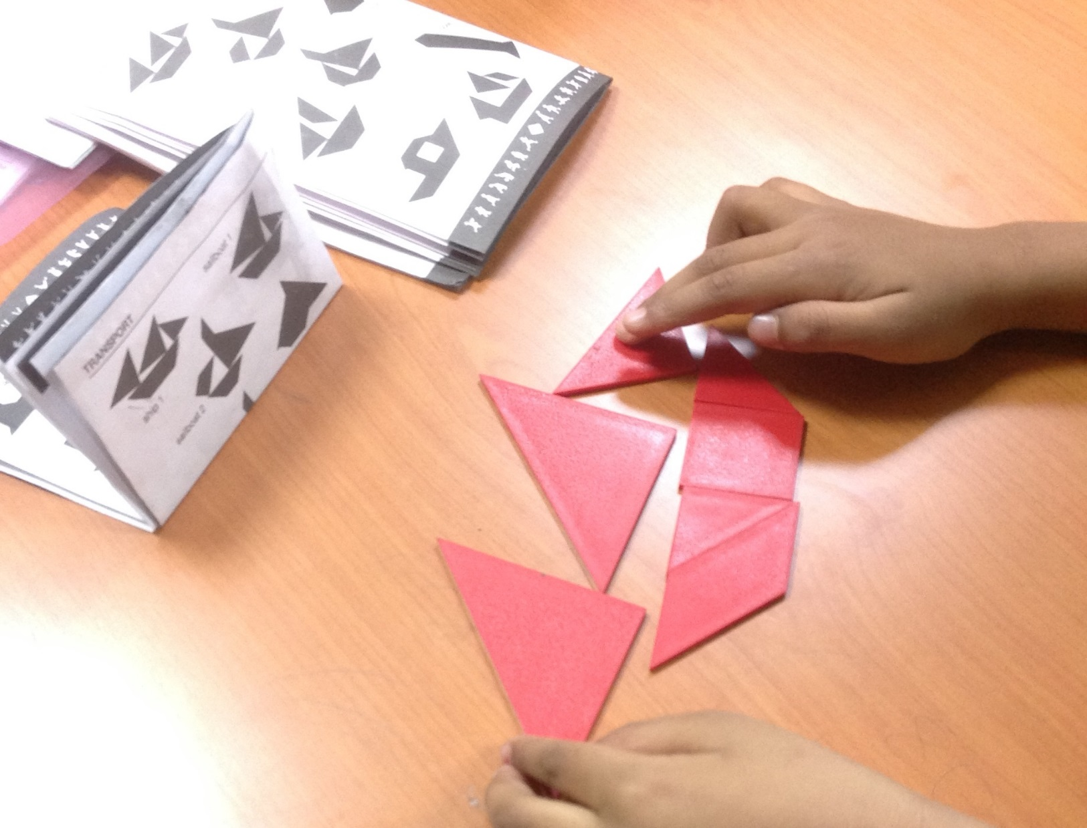
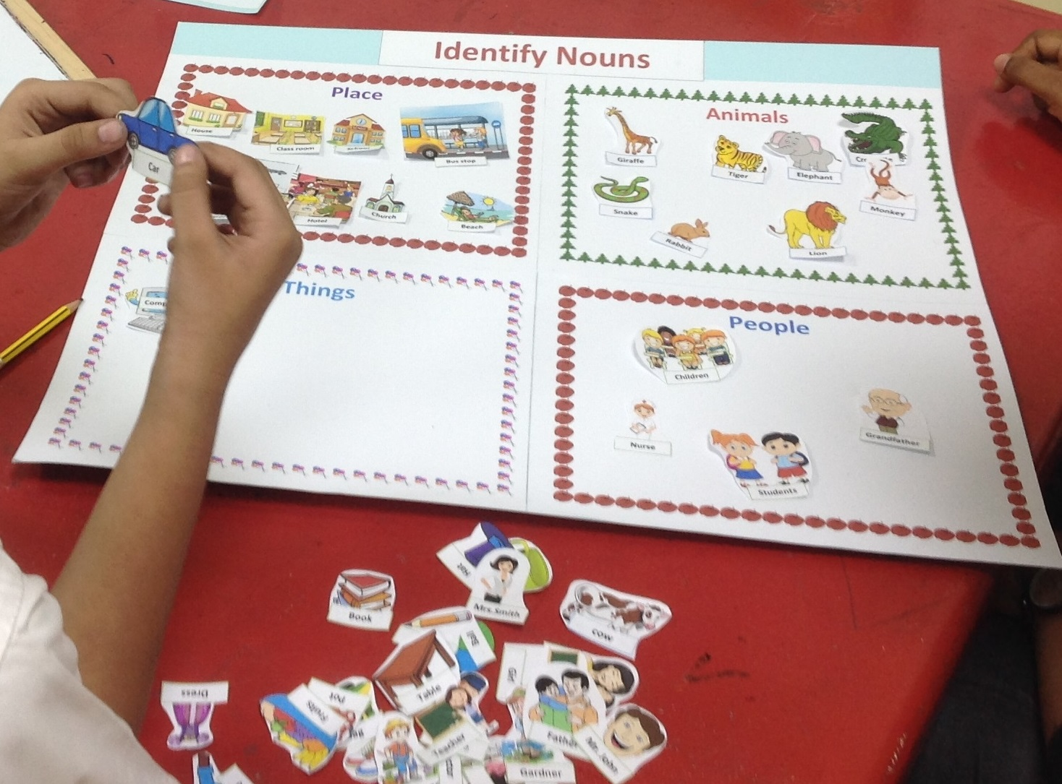
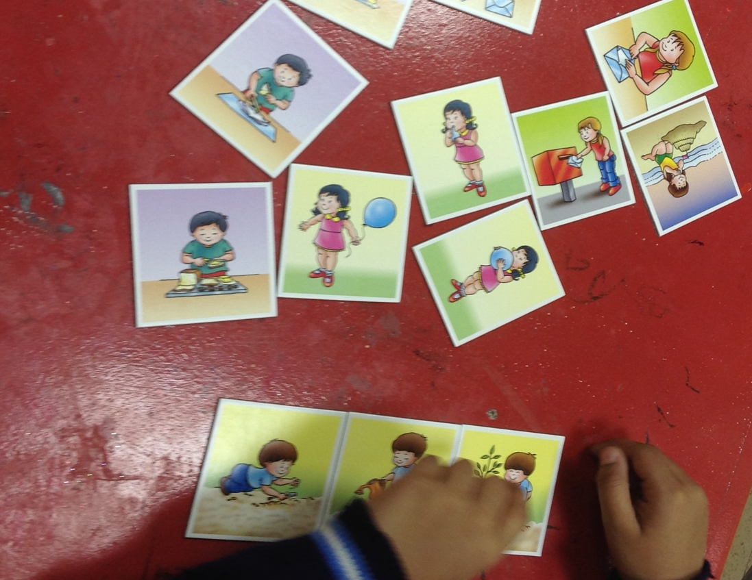
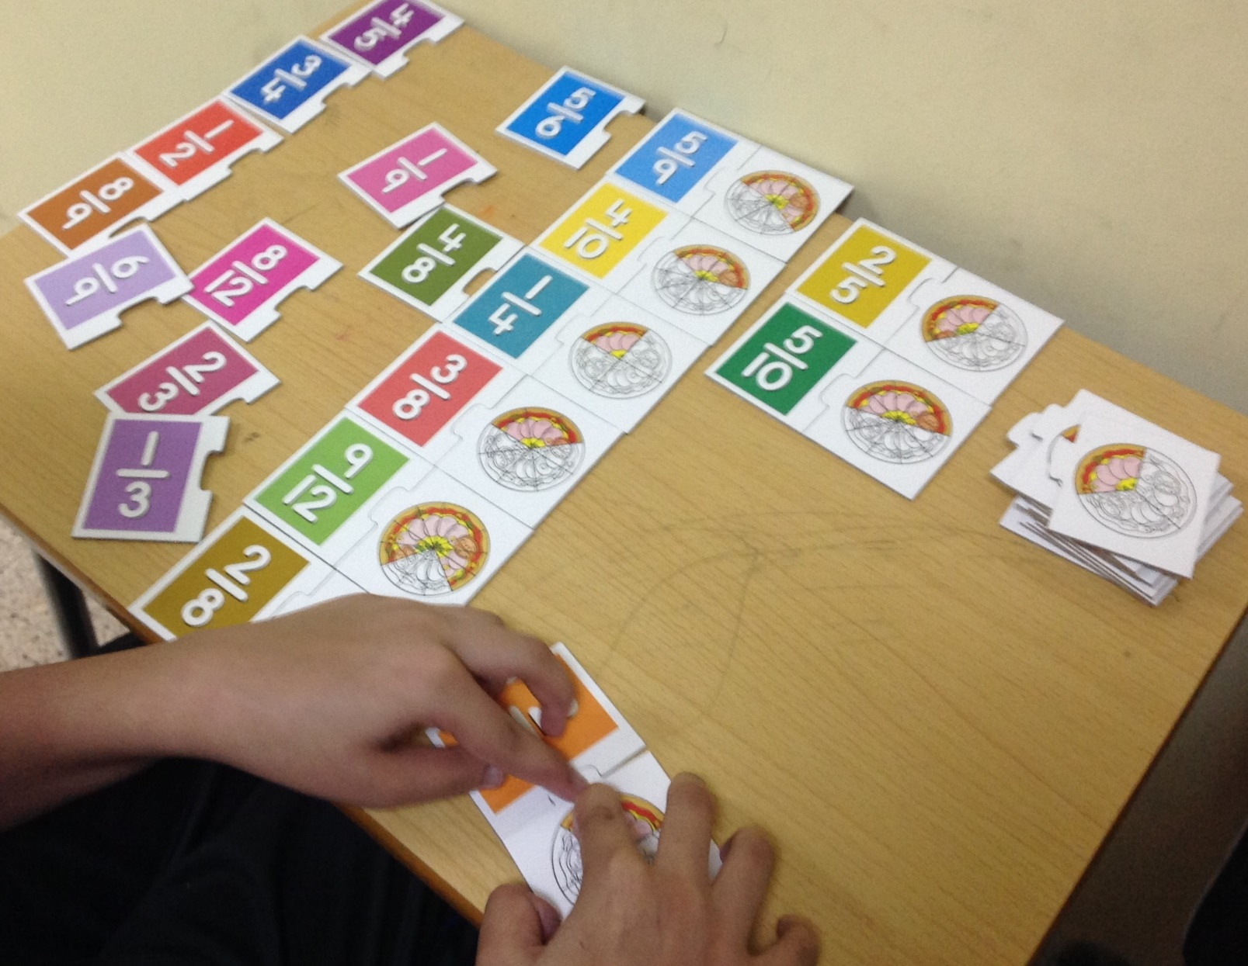
Remedial intervention Focus on Academic & Personal growth
Curriculum Areas
Social skills
Attention & Concentration
Co- ordination
Fine motor & Gross motor
Memory skills
Behaviour modification
Imagination skills
Cognitive skills

Slide 6
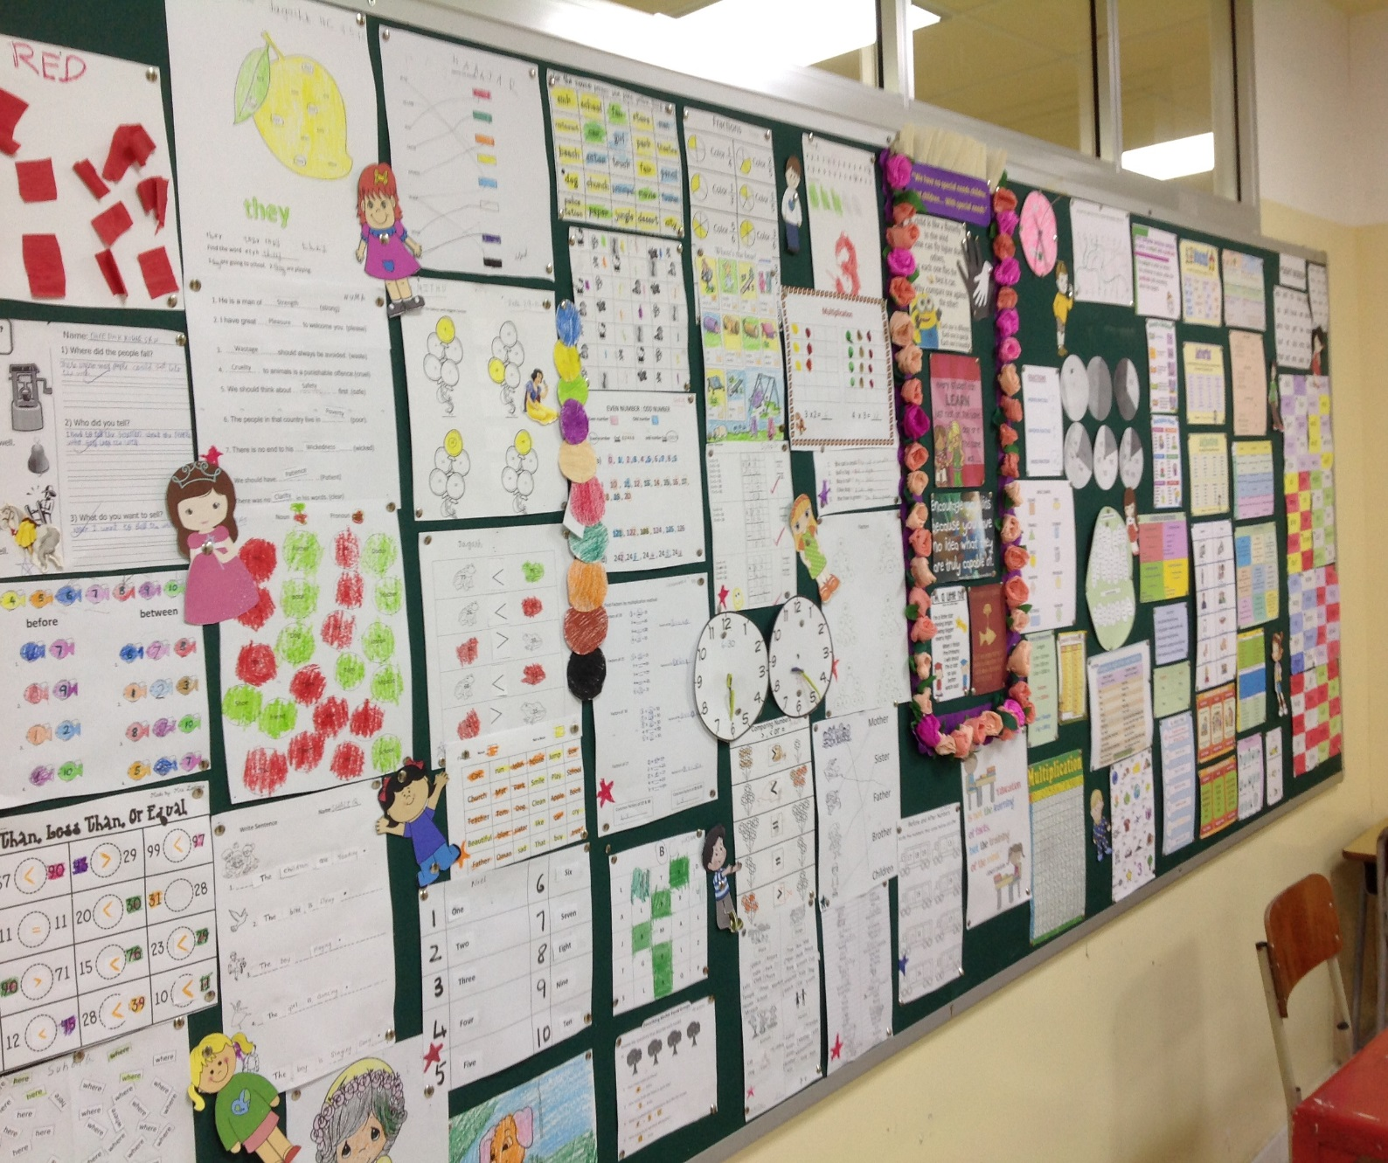
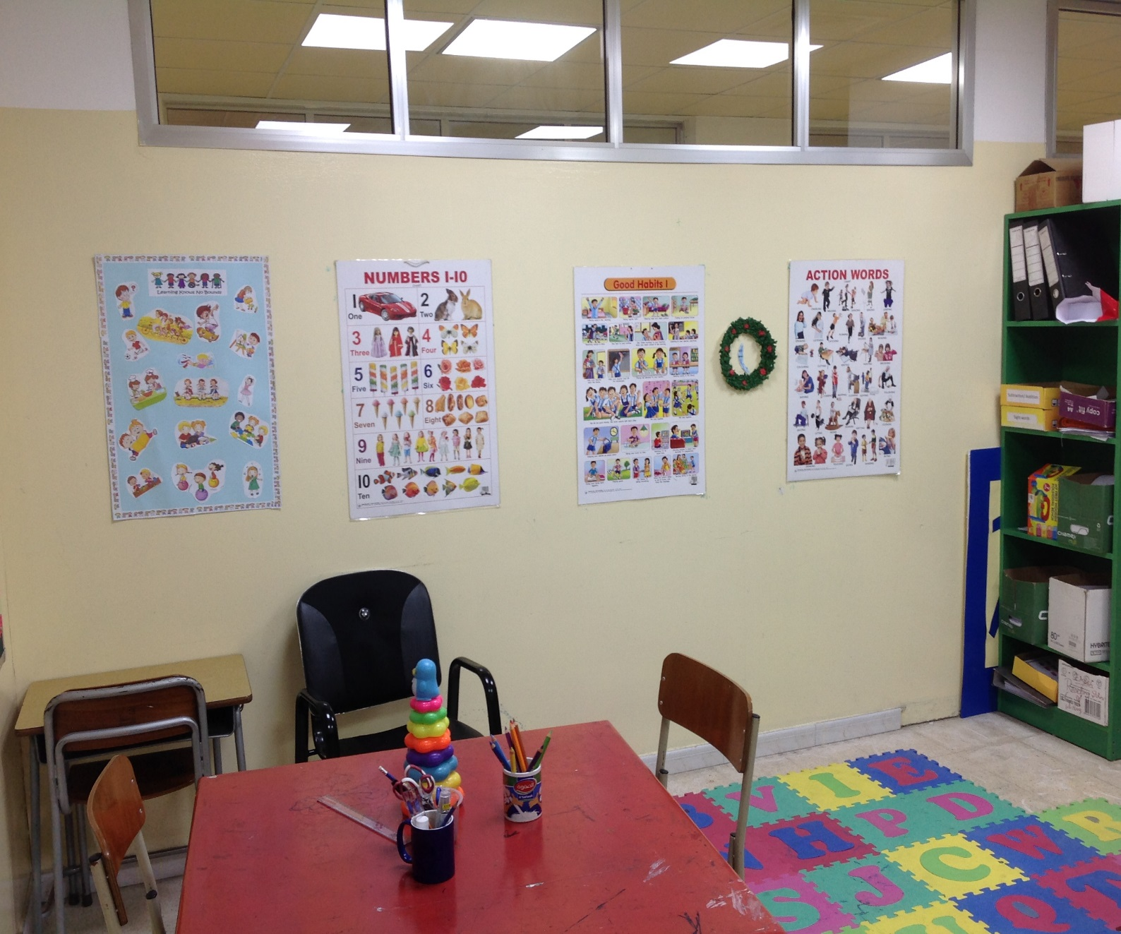
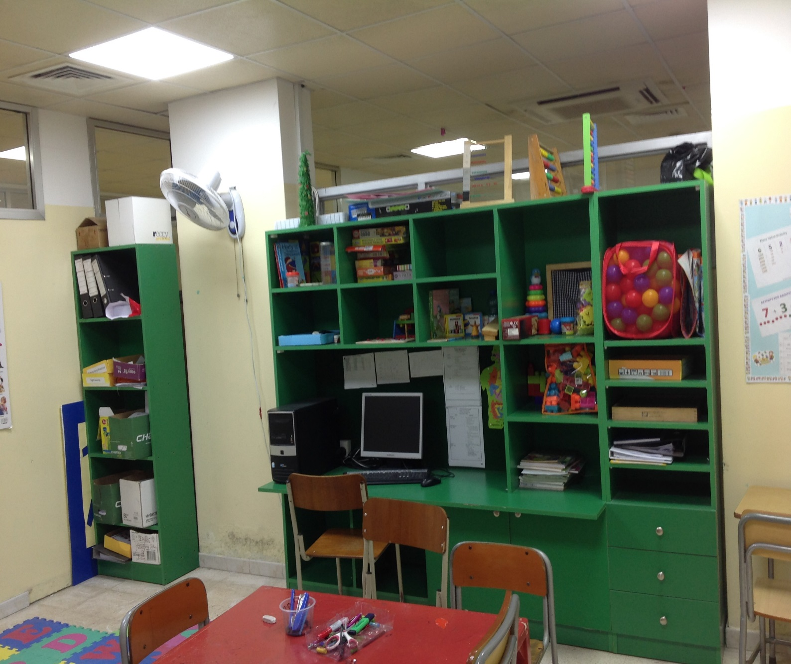
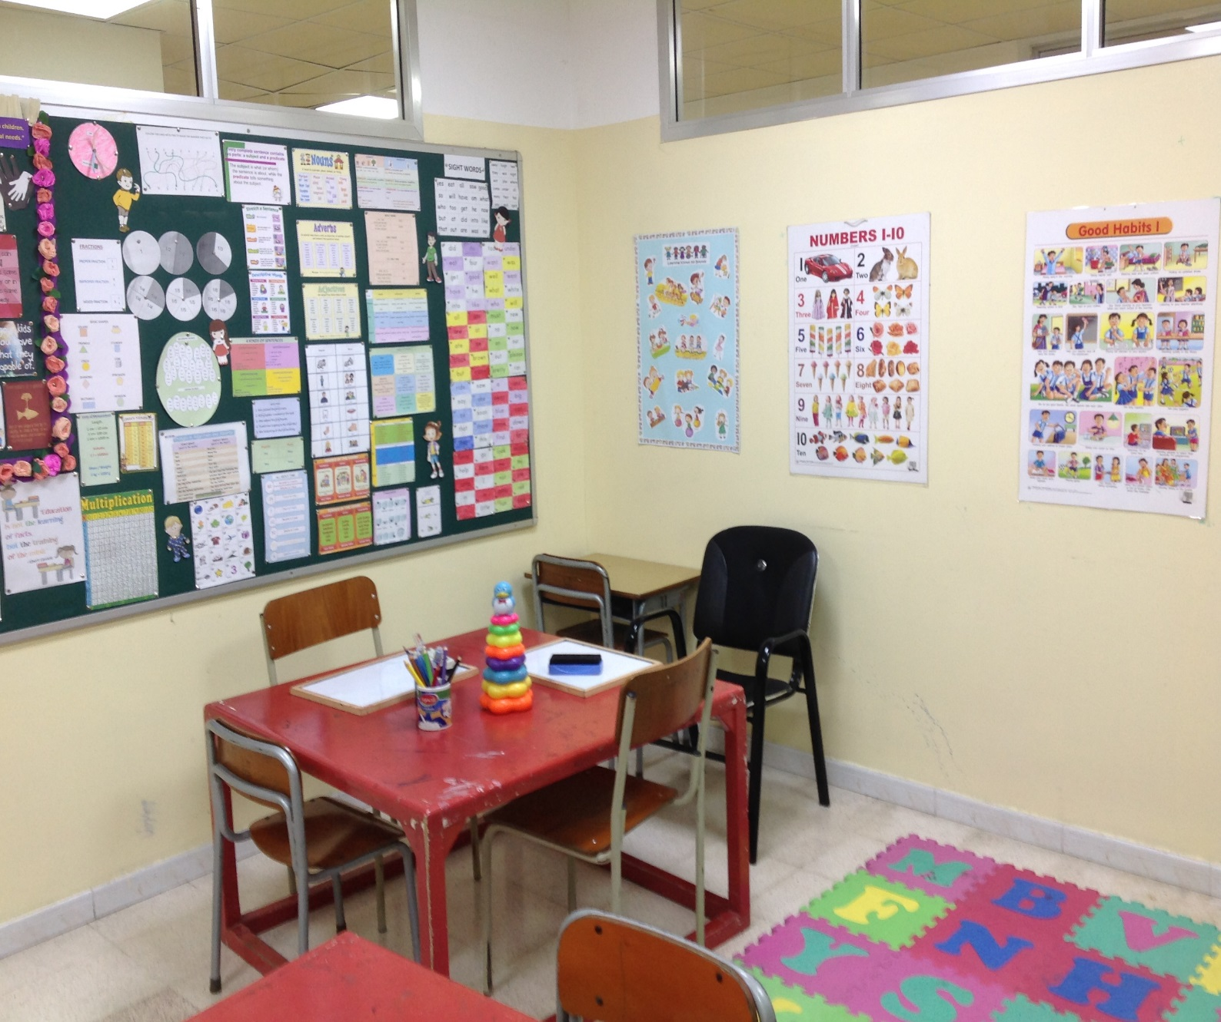
RESOURCE ROOM Stress free & Less distracting environment
Focus on individual needs of the student
Tailor-made worksheets
Equipped with Educational aids
Innovative teaching-learning process with multi sensory techniques
one-to-one / Small Group Sessions
Once or twice a week

Slide 7
Procedure
Referral
(Teachers/ Parents)
Periodic Review
Preliminary Diagnosis
School level help
Parental counselling
External Referrals
(if needed)

Slide 8
CONTACT DETAILS
24814066 Ext. 27
counsellor.metty@iswkoman.com
Basement Floor - Primary
7 AM – 4 PM
PRIOR APPOINTMENT IS MANDATORY

