Slide 1
Welcome Dear Parents
To
The Orientation Programme
2018– 2019
For Class : VII &VIII

Slide 2
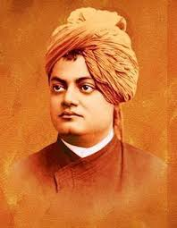
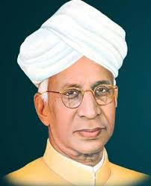
Introducing our Teachers
“A good teacher can INSPIRE hope, IGNITE the imagination, and INSTILL a love of learning.”
“One child, one teacher, one book, one pen can change the world.”

Slide 3
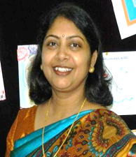
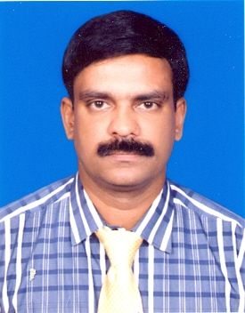
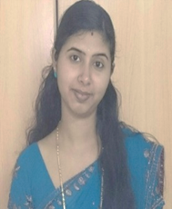
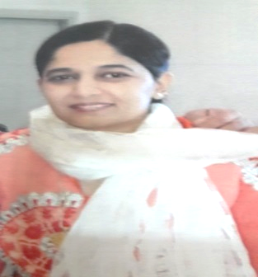
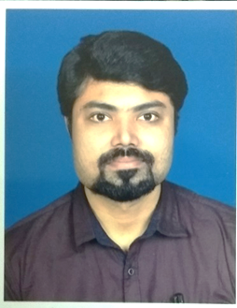
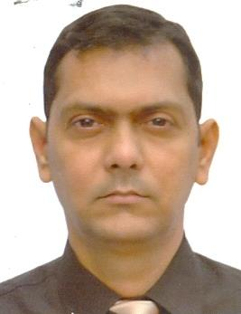
CLASS Vii English Teachers

Slide 4
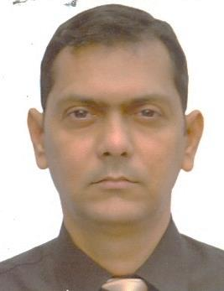
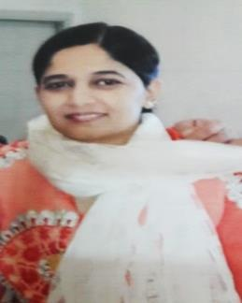
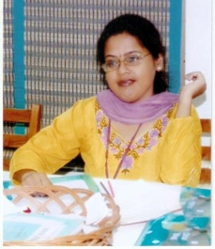
Middle School English Teachers Teaching Class VIII

Slide 5
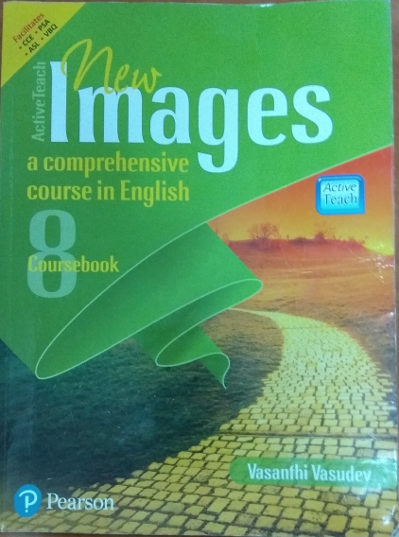
BOOKS PRESCRIBED FOR MIDDLE SCHOOL CLASS- VII&VIII

Slide 6
INTERNAL ASSESSMENT (20%) | INTERNAL EVALUATION
Notebook Submission (5%) (Regularity, Punctuality, Neatness & Notebook upkeep) | 10% of Pre-Mid Term, Mid Term & Post Mid-Term marks

Slide 7
Subject enrichment activities (5%)
Language 1 ENGLISH -SPEAKING AND LISTENING SKILLS

Slide 8
List of ACTIVITIES
READING COMPREHENSION | WRITING SKILLS | READING | LITERATURE MCQ
POEM RECITATION | DIARY ENTRY | DICTIONARY ACTIVITY | BROCHURE
SONNET | STORY TELLING TO FILM MAKING | LISTENING | QUESTIONNAIRE AND INTERVIEW

Slide 9
CO-CURRICULAR ACTIVITIES
Inter house English debate
Inter house English elocution
Inter school English drama competition
Jhankaar spectrum
Annual exhibition
Gavel club

Slide 10
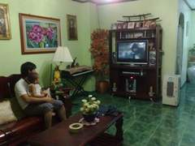
IMPORTANT

Slide 11
Thank you

