Slide 1
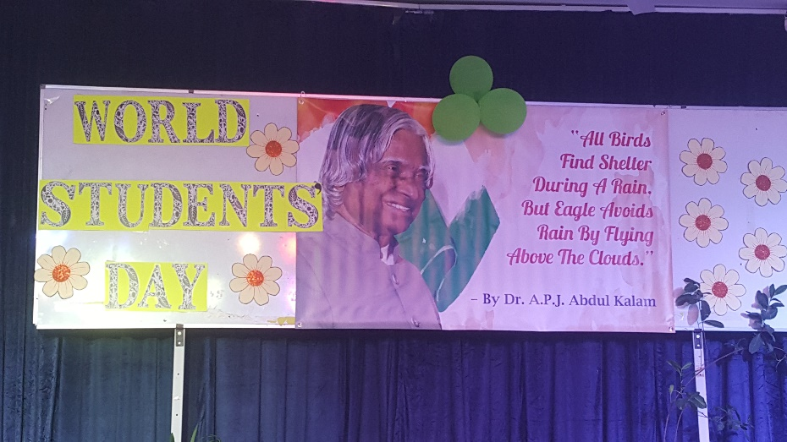
WORLD STUDENTS’ DAY
THE STUDENTS OF IV L, PRIMARY SECTION (AFTERNOON SHIFT) CONDUCTED A SPECIAL ASSEMBLY ON WORLD STUDENTS’ DAY, THE BIRTH ANNIVERSARY OF INDIA’S MOST LOVED PRESIDENT, DR.A.P.J. ABDUL KALAM, ON 15TH OCTOBER, 2018.
It was attended by the Vice Principal, the teachers and all the sections of classes one to five of the Afternoon Shift. The students entertained the children with a melodious song and enlightened them with information on Dr Kalam. They presented two videos on the life of Kalam and his rules of success.

Slide 2
Due to his love for students and focus on promoting education, the United Nations declared his birthday (October 15) as ‘World Students Day’ in 2010.

Slide 3
You have to dream before your dreams can come true. – dr.a.p.j.abdul kalam

Slide 4
Science is a beautiful gift to humanity; we should not distort it. – dr.a.p.j. abdul kalam

